Slide 1
“how CRE can leverage Social & Digital to make sure that they are front of mind in the buying decision”

Slide 2
“What modern selling means for Business Development and Marketing in Law firms”
Follow me @alexander_low
#IAShare2018

Slide 5
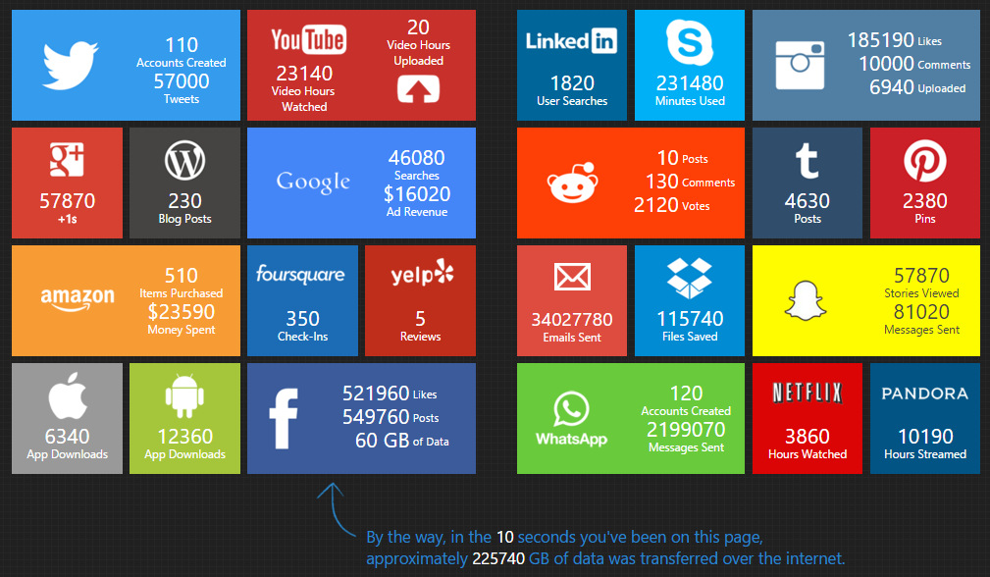

Slide 6
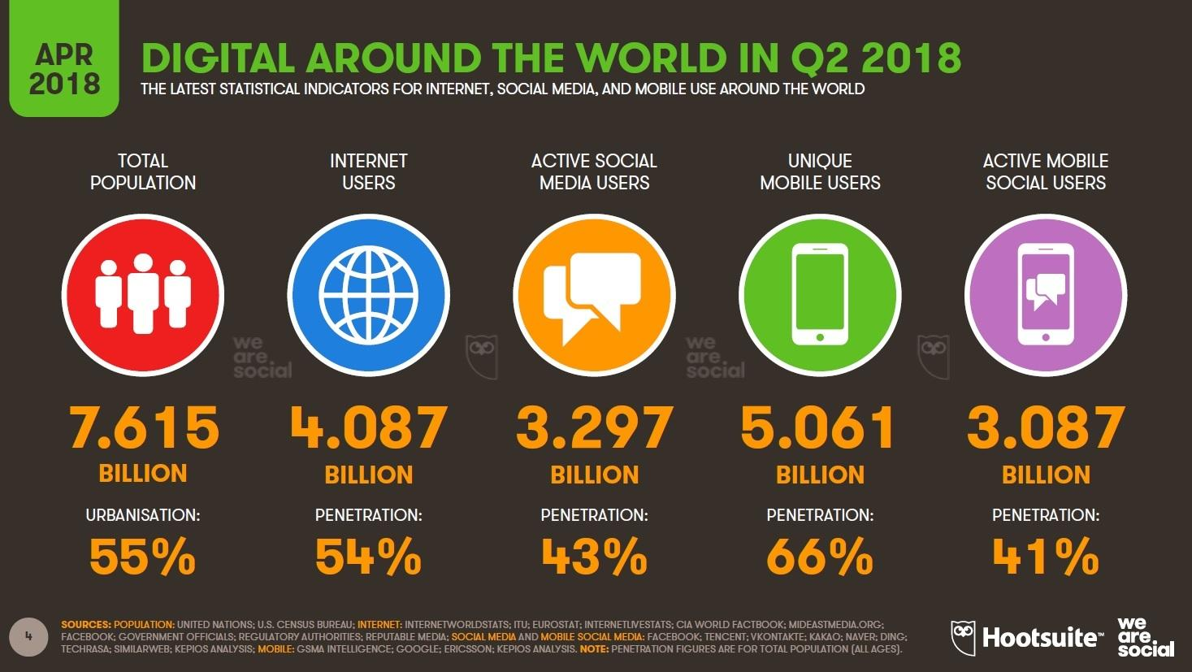

Slide 7
Imagine…
Notes:
Minute 11
Close your eyes and imagine this scenario. You are out for dinner with your friends and you start to suffer with terrible stomach pains. The pains are so bad that your friends phone for an ambulance and you are admitted to hospital.
When you are waiting to be seen, you have two people who you could approach.

Slide 8
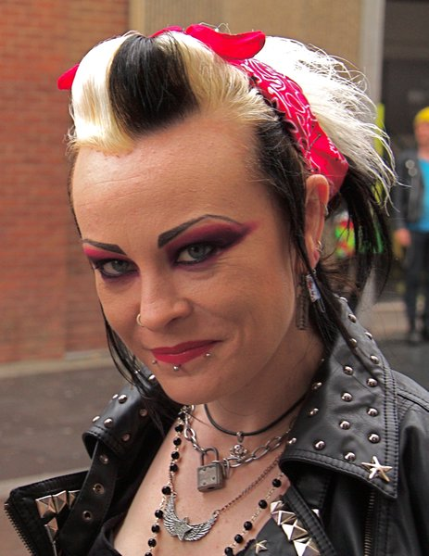
1
2
Notes:
Minute 11
Which one would you choose? [show of hands for doctor 1 and doctor 2]
As it happens doctor 1 is the world’s best gastroenterologist who has been at a fancy dress party and has come back to hospital just to see you. “doctor 2” is in fact not a doctor, but the receptionist who is taking a stethoscope to doctor 1!!!
But, do you see what you all did?

Slide 9
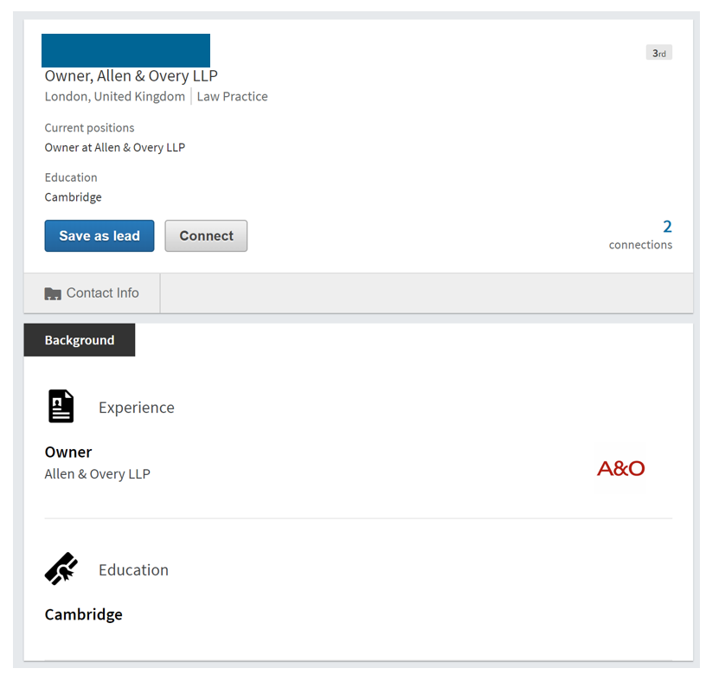
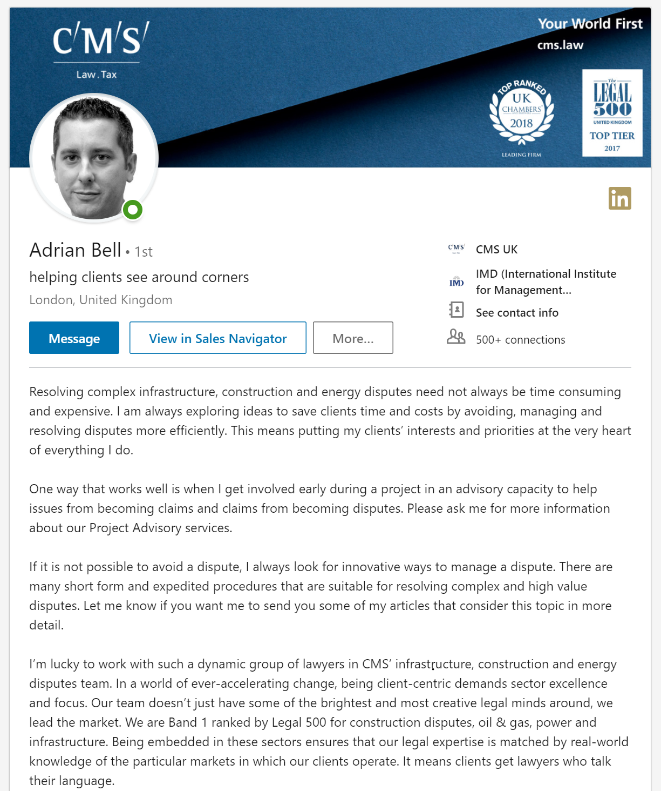
Notes:
Minute 11
Which one would you choose? [show of hands for doctor 1 and doctor 2]
As it happens doctor 1 is the world’s best gastroenterologist who has been at a fancy dress party and has come back to hospital just to see you. “doctor 2” is in fact not a doctor, but the receptionist who is taking a stethoscope to doctor 1!!!
But, do you see what you all did?

Slide 10
we ALL jump to conclusions
Notes:
Minute 12
You jumped to a conclusion based on a little bit of knowledge. EVERYBODY jumps to conclusions. Because this is a normal human behaviour you need to recognise that people are going to jump to conclusions about you and the job of your social profiles is to make sure that they jump to the conclusions that you want.

Slide 11
The Buying Experience
Notes:
Minute 12
You jumped to a conclusion based on a little bit of knowledge. EVERYBODY jumps to conclusions. Because this is a normal human behaviour you need to recognise that people are going to jump to conclusions about you and the job of your social profiles is to make sure that they jump to the conclusions that you want.

Slide 12
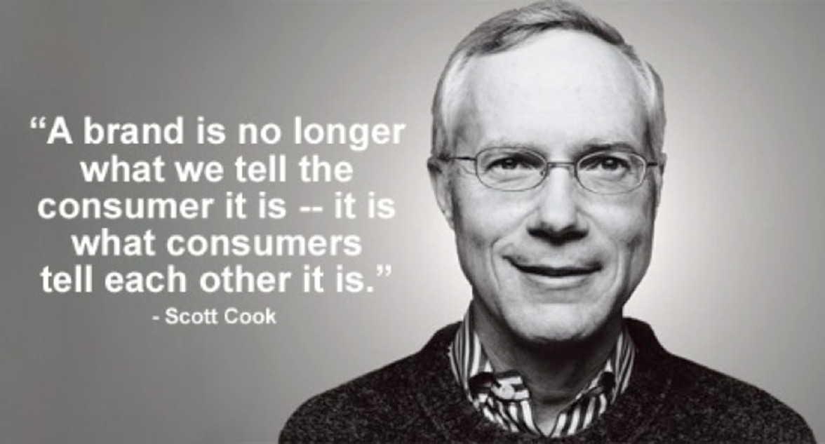
Notes:
Minute 12
You jumped to a conclusion based on a little bit of knowledge. EVERYBODY jumps to conclusions. Because this is a normal human behaviour you need to recognise that people are going to jump to conclusions about you and the job of your social profiles is to make sure that they jump to the conclusions that you want.

Slide 13
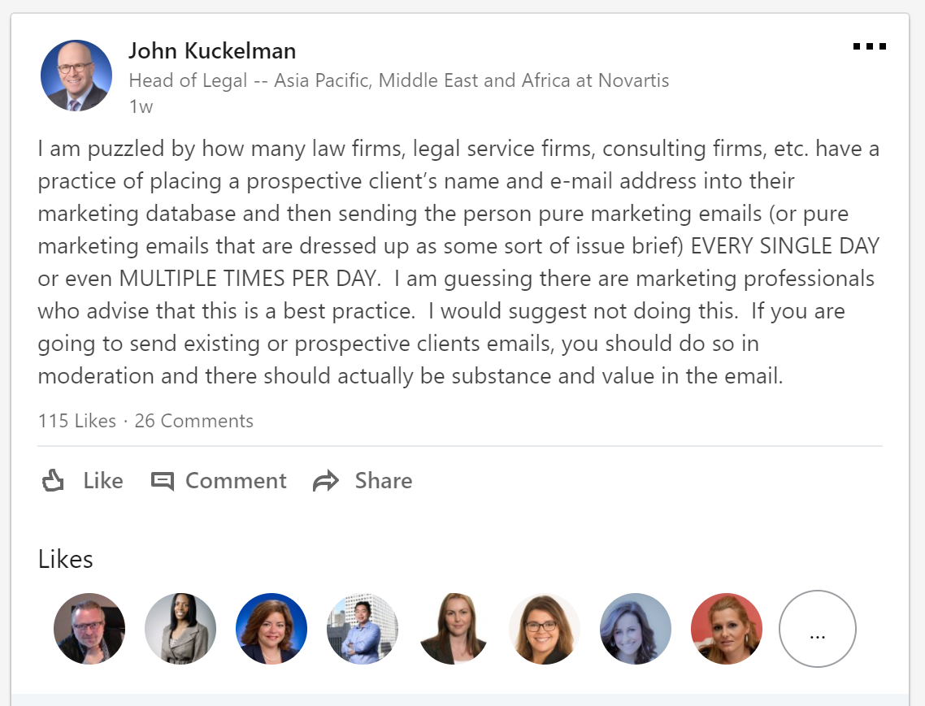
Notes:
Minute 12
You jumped to a conclusion based on a little bit of knowledge. EVERYBODY jumps to conclusions. Because this is a normal human behaviour you need to recognise that people are going to jump to conclusions about you and the job of your social profiles is to make sure that they jump to the conclusions that you want.

Slide 14
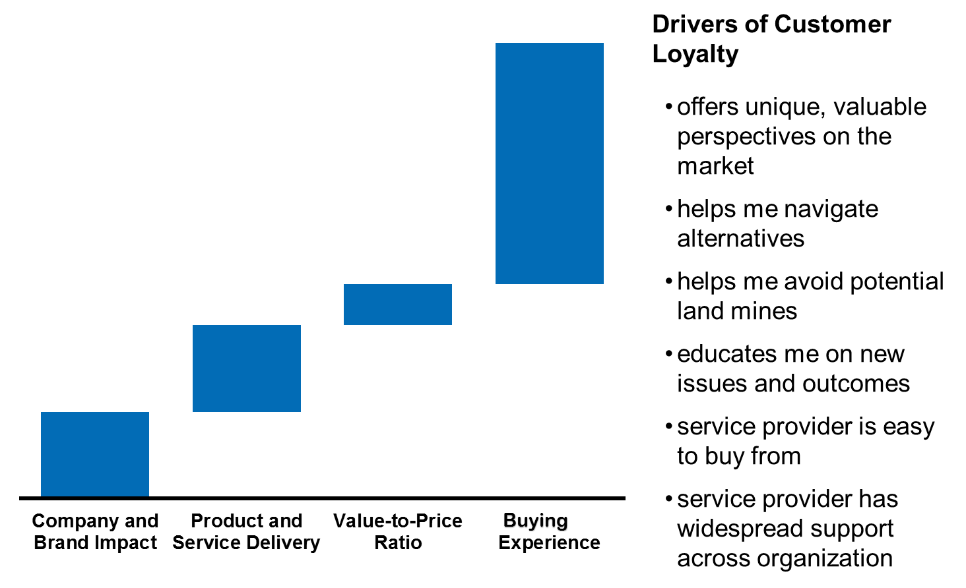

Slide 17
Data, Data, Data…

Slide 18
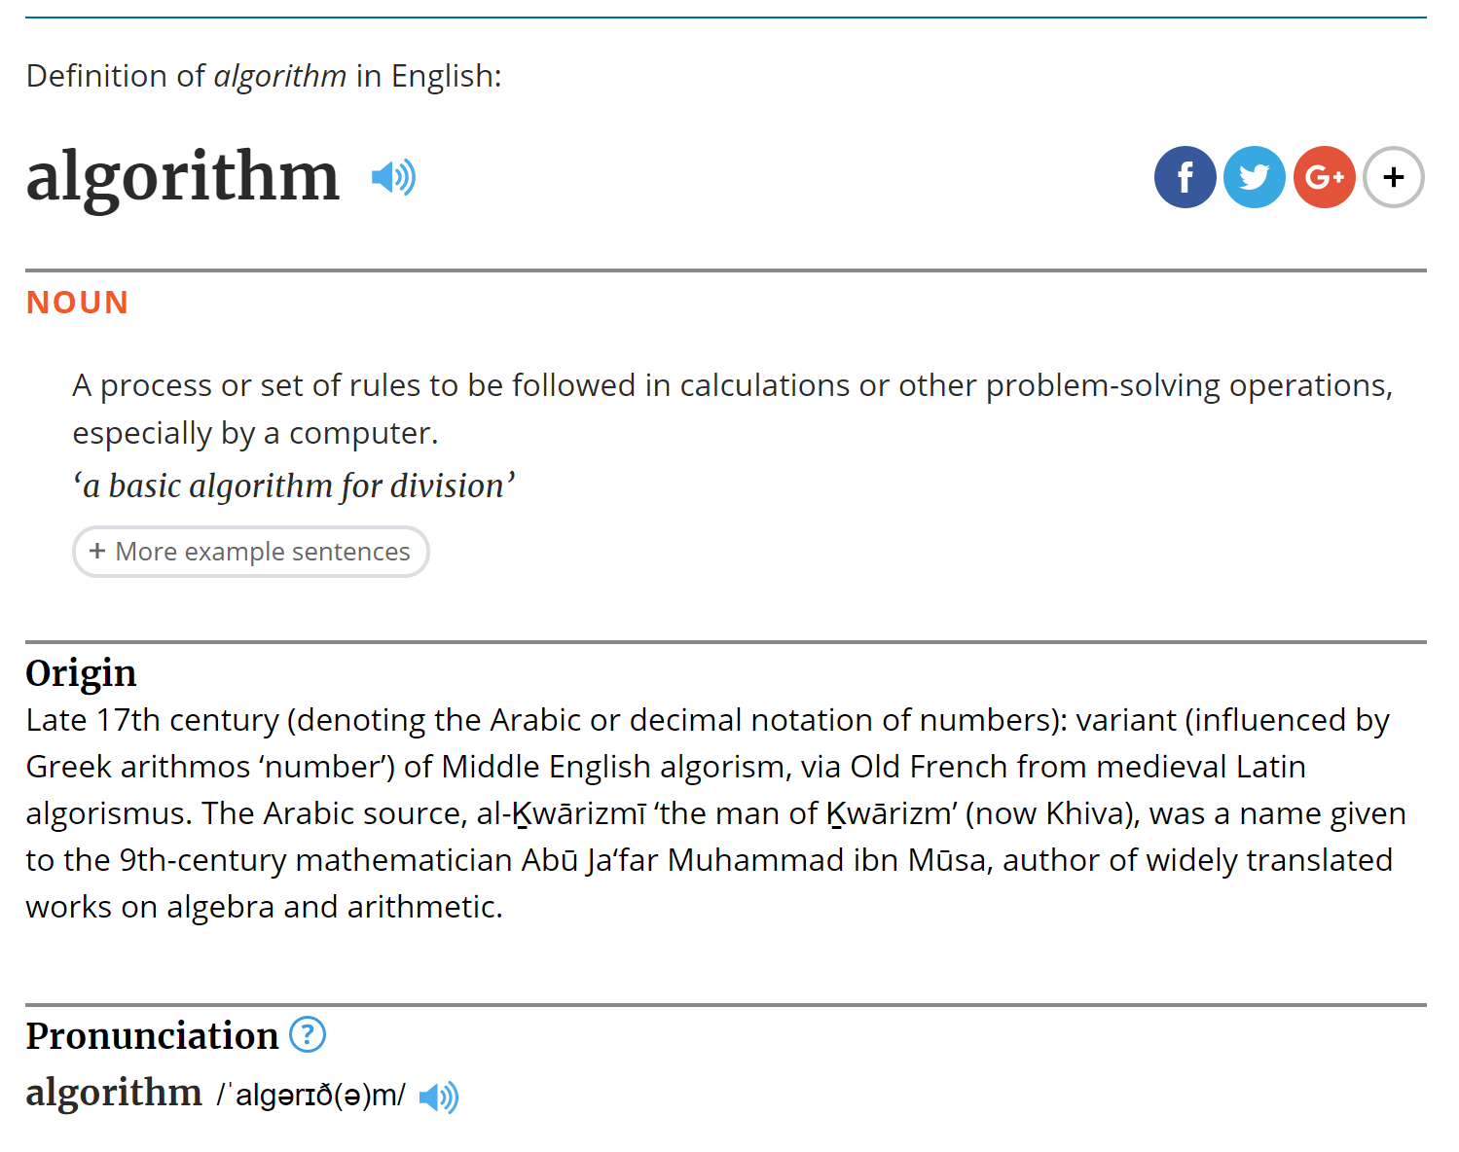

Slide 19
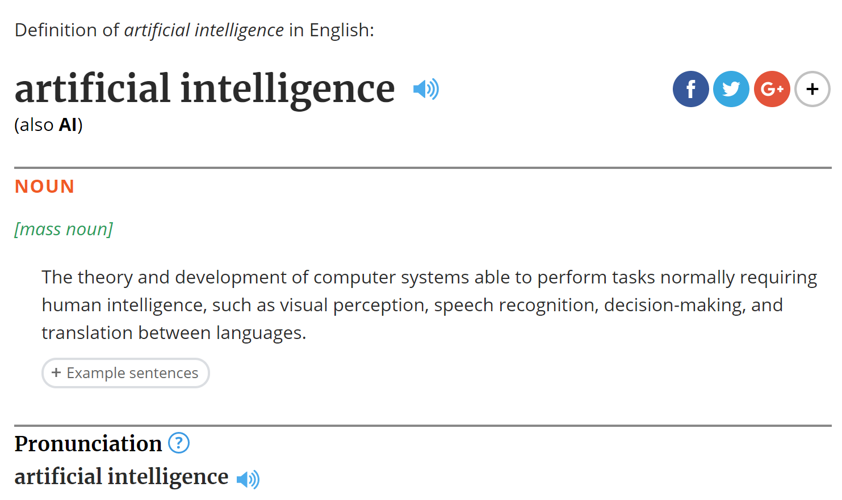

Slide 20
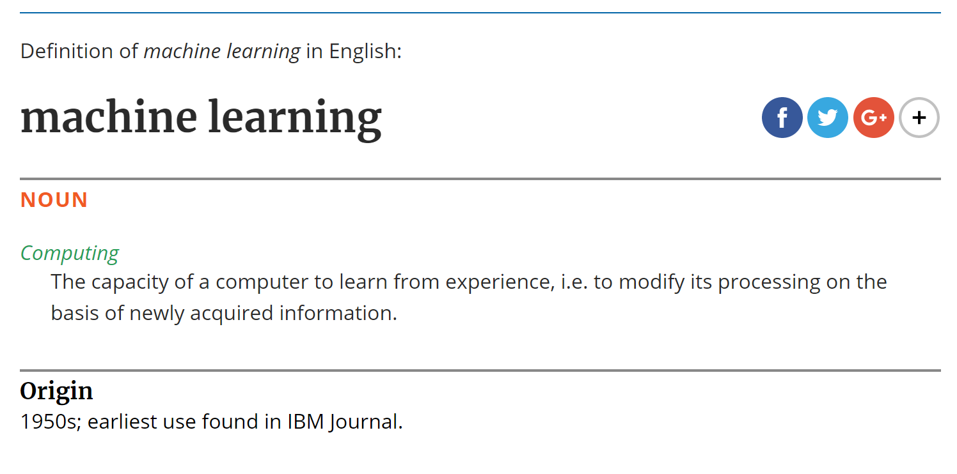

Slide 21
So what does this all mean for you?

Slide 22
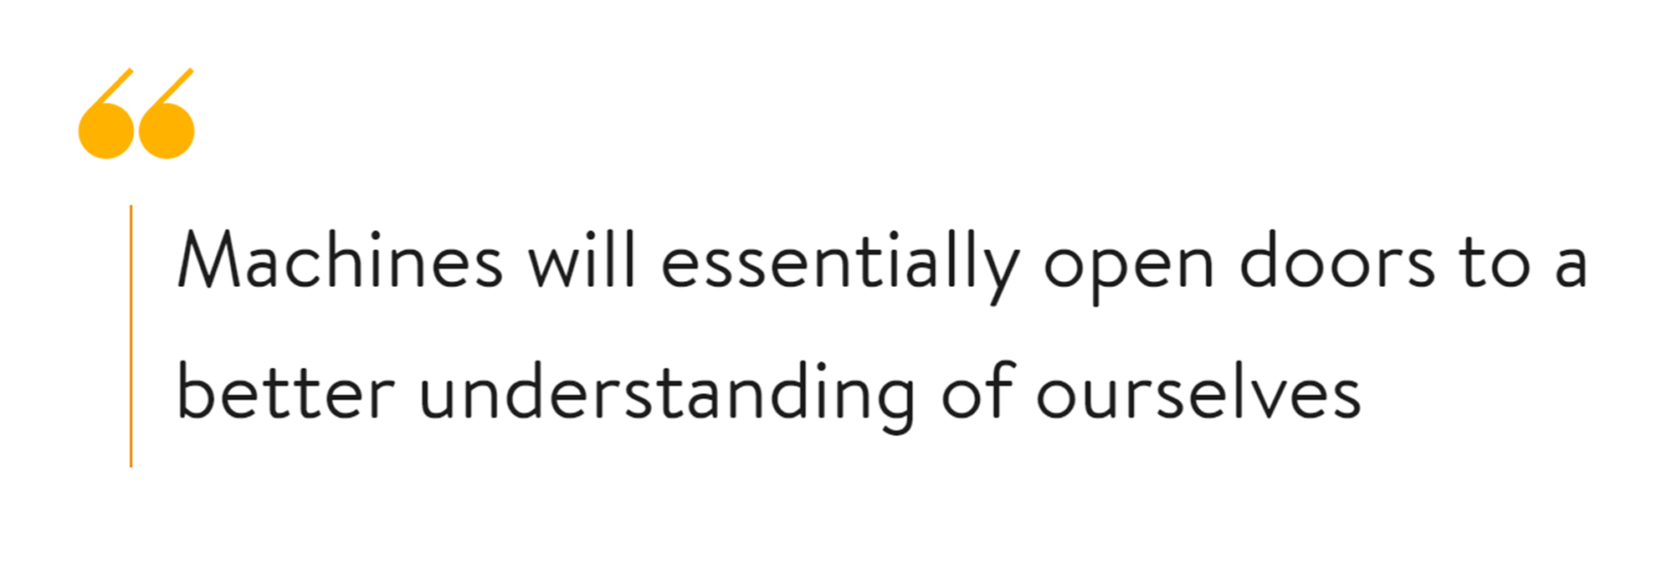

Slide 23
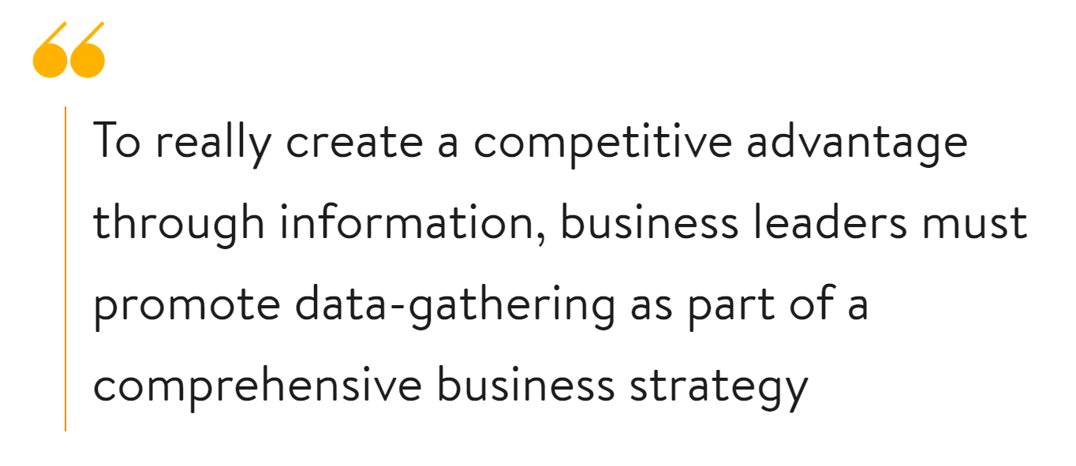

Slide 24
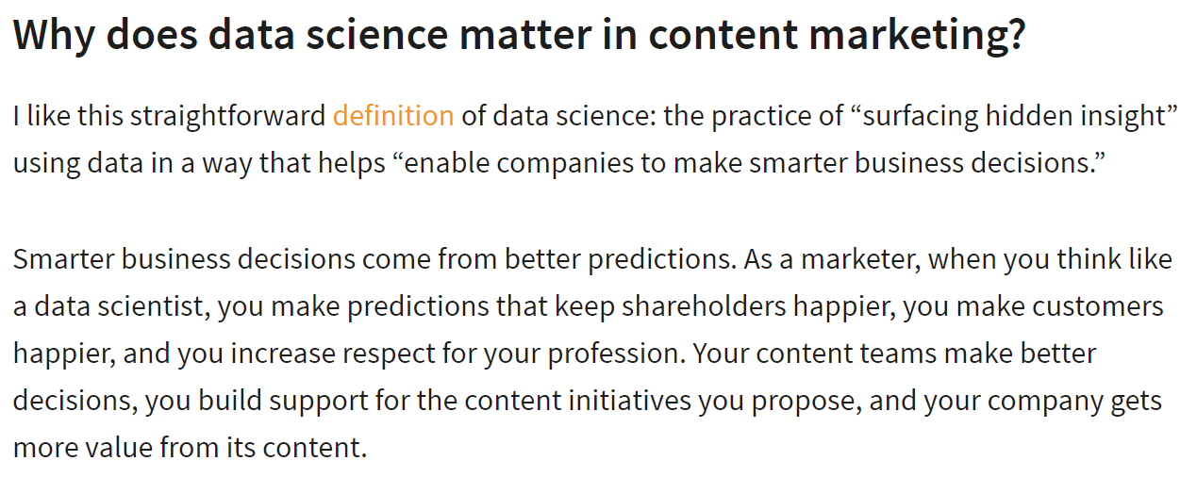

Slide 31
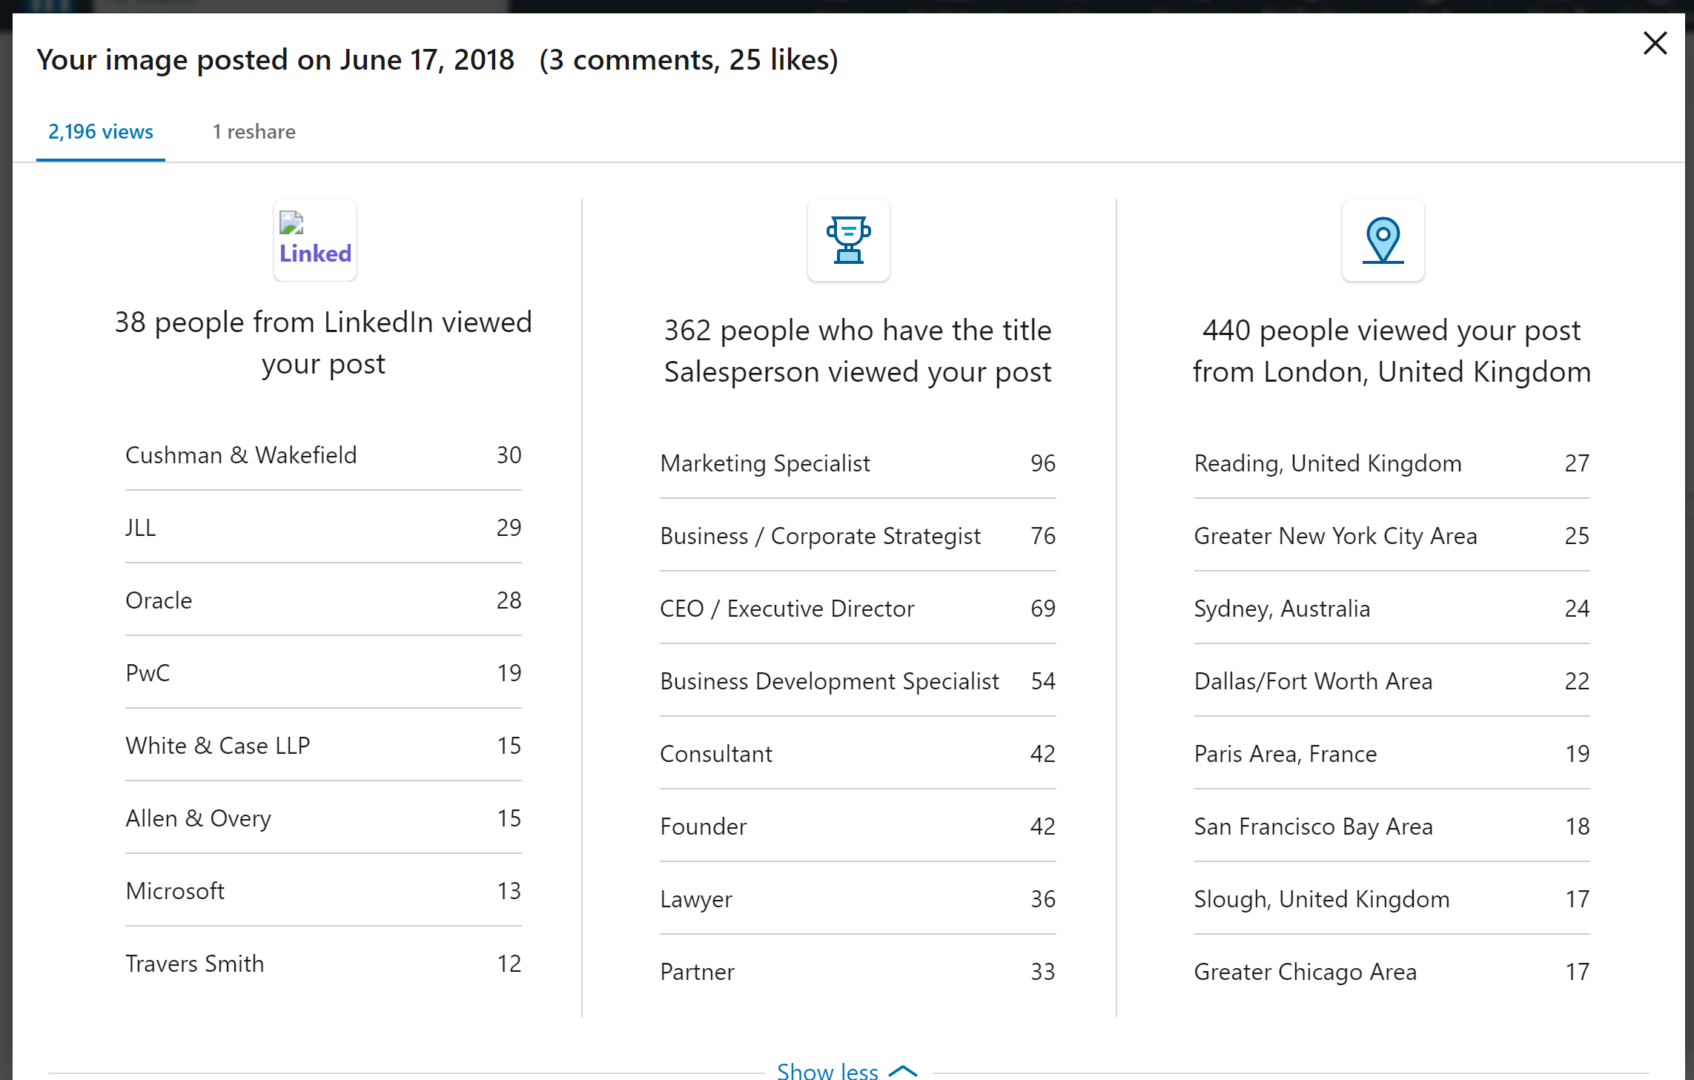

Slide 33
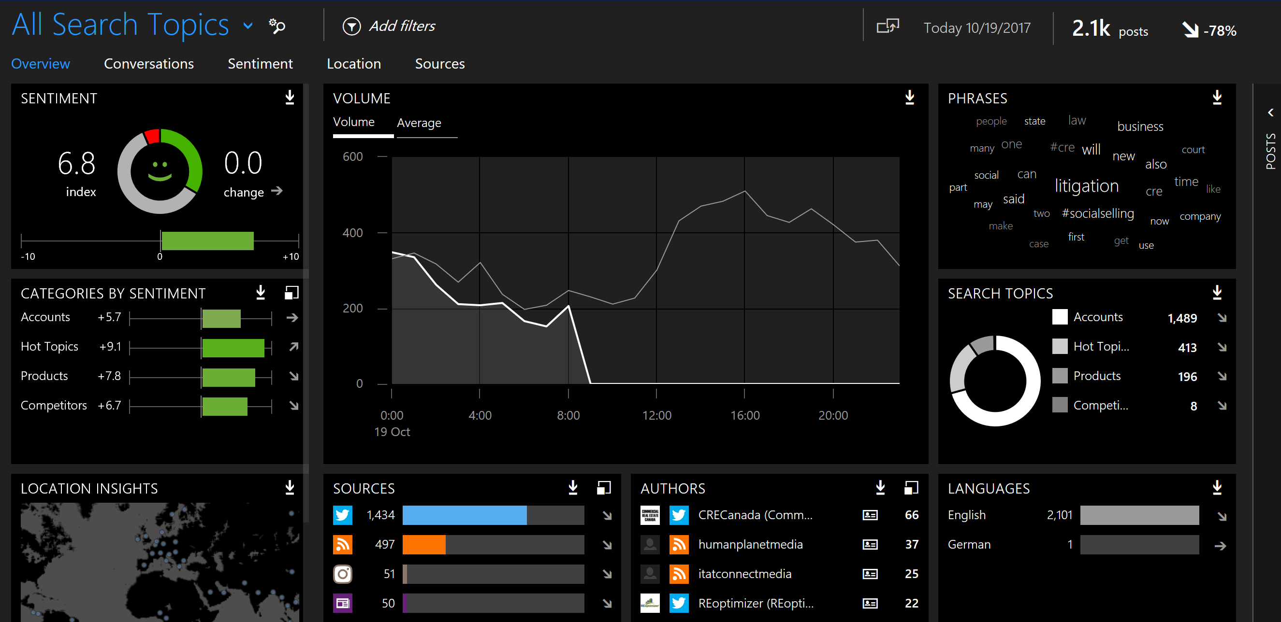

Slide 34
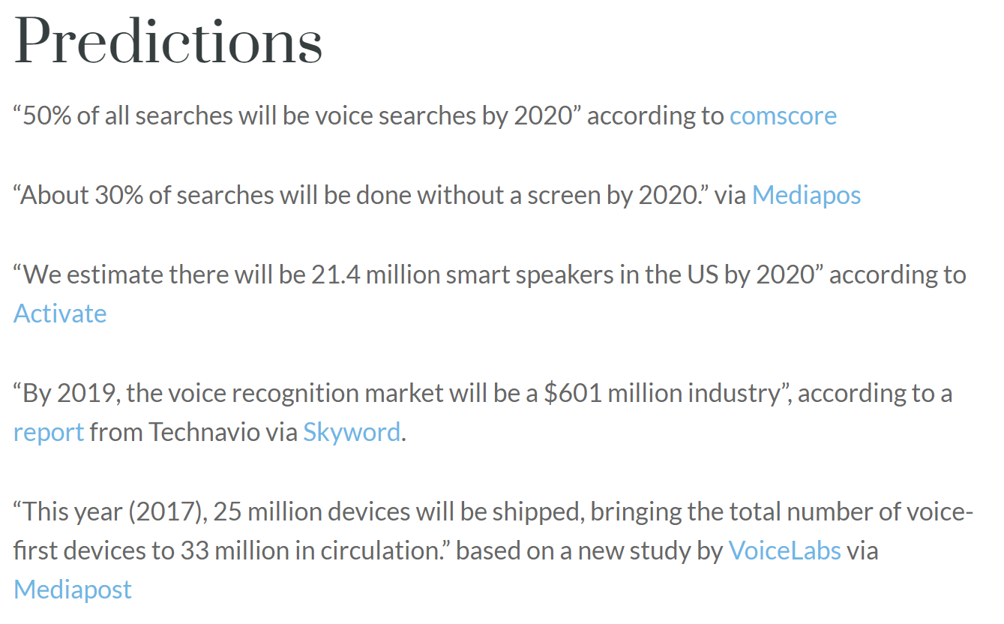
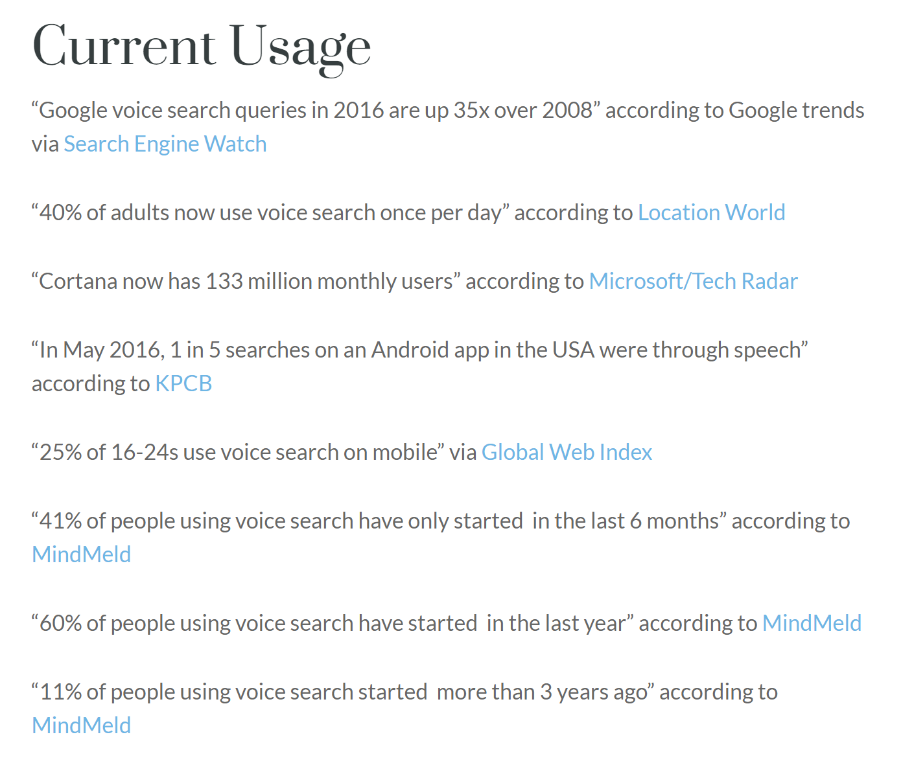

Slide 35
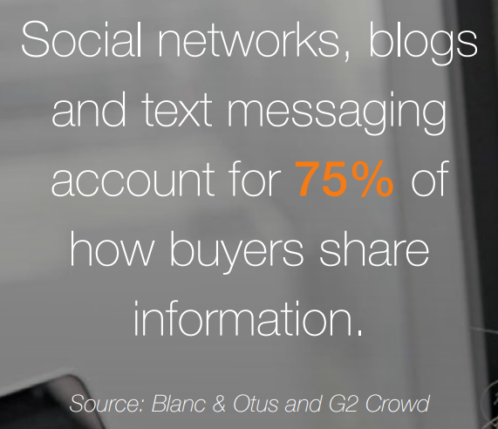
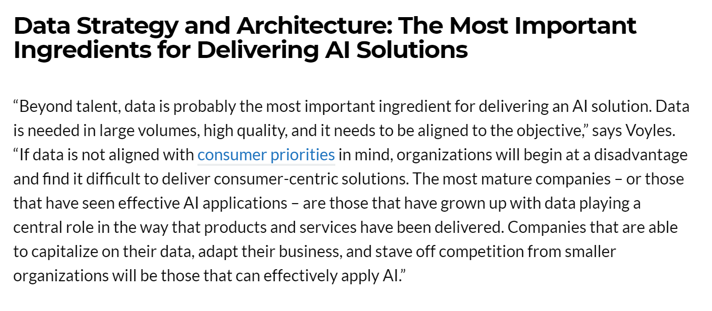

Slide 36
