Slide 2
Enterprise Solutions

Slide 3
Marcus Hutchinson
Building Solutions with Visualfiles Online
Enterprise Solutions

Slide 4
Agenda
What is Visualfiles Online?
Why Build An Online Solution
Example Application
Important Considerations
Enterprise Solutions
Notes:
We will start with a quick overview of Online and why you might use it.
We will run through some very important considerations to be planned before starting a project.
The session is an overview building an example application
Will pull out some interesting code snippets
Full source code and documentation will be available
Not going to be showing every line of code
Not a training course for HTML

Slide 5
Agenda
What is Visualfiles Online?
Why Build an Online Solution
Example Application
Important Considerations
Enterprise Solutions
Notes:
Start with the background to Visualfiles Online.

Slide 6
What is Visualfiles Online?
“A toolkit allowing the creation of Visualfiles applications delivered securely over the internet.”
Notes:
A toolkit allowing the creation of Visualfiles applications delivered securely over the internet.
It’s a Visualfiles service on the web.
Allows easy creation of applications or the embedding of Visualfiles functionality into existing portals, giving secure remote access to the live system.

Slide 7
What is Visualfiles Online?
A Visualfiles service on the web
Receives instructions as HTTP requests
Responds with information packaged as XML
Allows access to Visualfiles from any compatible device
Simple set of function calls to standard Visualfiles objects
Notes:
In its simplest form,
The service can receive instructions as HTTP requests
It responds back with information contained in XML form.
Applications written using Online can be run on any compatible device (phones, tablets, pc’s, macs, chromebooks etc.)
It has a small set of developer friendly functions for entity, case, history, schedule, documents, VBL etc.

Slide 8
What is Visualfiles Online?
A Visualfiles service on the web
Invoke system scripts, search, retrieve and update data
Upload and download documents
Honour the Visualfiles security model
Notes:
You can
Run system scripts arguably its most powerful feature.
Search for entities and cases.
Retrieve and update data on screens.
Upload and download documents.
All of which are protected by the Visualfiles security features.

Slide 9
Agenda
What is Visualfiles Online?
Why Build an Online Solution
Example Application
Important Considerations
Enterprise Solutions
Notes:
Let’s explore why you might want to build an online application with some typical use cases

Slide 10
Why Build An Online Solution
Provide alternate user interfaces:
For specific tasks or processes that benefit from bespoke interfaces
Dynamically changing forms
To deploy one solution across multiple brands
To address specific usability issues
Avoid the 30 field limit
Enterprise Solutions
Notes:
Some processes benefit from having a dedicated user interface tailored to the task
Perhaps a quotation process would work better with 1 dynamic input form rather than the traditional VF screen limited to 30 fields. Like car insurance quote – answer one question (add named drivers) and the form changes.
You may have “the same” product or process but branded differently – a number of trading organisations under company umbrella
Claims handling, insurance services
Online forms can be tailored to specific disability needs – colours, font sizes, animations.
Forms can be provided in multi-language variations with different layouts based on label text.

Slide 11
Why Build An Online Solution
Remote access:
Access live system from any location
Time Recording
Manage To-Do List
Connect using any compatible device
iPhone/iPad
Android Phone/Tablet
Case Tracker
Document Review
Chrome/Safari/IE/Edge
Mac/PC
Enterprise Solutions
Notes:
You may want to build an application that gives you specific functionality whilst out of the office – travelling or in court
Being internet based access from anywhere with a connection
Typical devices include iphone, ipad, android pone and tablet, Chrome, Safari, Microsoft Edge and Internet Explorer. But it could be any device that can send HTTP requests and process XML responses.

Slide 12
Why Build An Online Solution
Self-service:
B2C: Client portal secure access to specific case
Review progress
Download/Upload documents
B2B: Self-service for agents, experts and work providers
Create new case
Drive workflow
Submit instructions
Record fees
Generate quotes
Enterprise Solutions
Notes:
You may want to give your clients direct access to their cases. B2C
Review progress, submit instructions, download/upload documents.
You may want to give third parties access to perform certain tasks. B2B
Create a case, progress case to new stage, record fees
Of course, you don’t have to build an application for B2B, you could embed VF Online calls directly into the third parties own portals.
B2C and B2B -> self-service reduces cost.

Slide 13
Agenda
What is Visualfiles Online?
Why Build An Online Solution
Example Application
Important Considerations
Enterprise Solutions
Notes:
Before building a solution there are important considerations and decisions to plan.

Slide 14
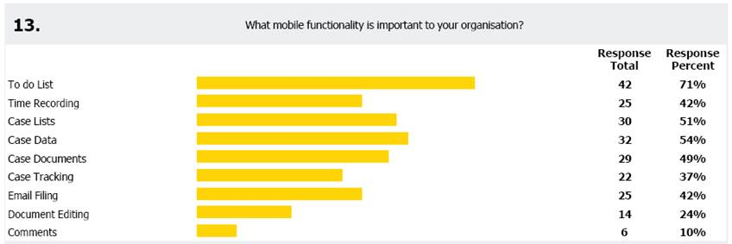
Example Application
Share 2016
What mobile functionality is important to your organisation?
Notes:
So last year we included a question in our feedback form, what mobile functionality would be important to your organisation. The leading area, with 71% of respondents was To-Do list so my example is a simple application based on the items in the to-do list.

Slide 15
Example Application
Simple view of “your” organisations task list
Select a task and edit details
Date Due (date picker)
Fee Earner (selection list)
Description (notes box)
Priority (selection list)
Category (selection list)
Notes:
After successful login a list of all to do items for cases that you are permitted to access (more on this later)
Options to filter results based on priority and/or category.
Category and priority represented by icons
Select a task and edit date due (includes cross browser date picker), fee earner (from a list), description, priority (from a list) and category (from a list).
Check for
disabled JavaScript
Invalid logins
Errors returned from Visualfiles service

Slide 16
Example Application
Security
Multiple organisations
Restricted entities
Obfuscated URL
Handler mappings
HTTP Post
Notes:
The application will have data associated with multiple organisations. Users associated with one organisation will not be able to see data stored against other organisations.
The URL for the application will be fully obfuscated – using handler mappings and HTTP Post.

Slide 17
Example Application
Usability
Dynamic interface based on screen size
Consistent interface across device
Not all devices and browsers behave the same
Architecture
Use of XSL Includes
Error handling built into every page
Notes:
Need to be able to detect the width of the screen and dynamically change the contents displayed
Stop keyboards appearing unexpectedly (apple)
Stop unexpected auto scaling/zooming (apple)
Date input with picker working consistently across browsers – avoiding the html5 date input
Use of XSL includes to ensure common sections of code written once
Standard head, header, footer and error handling
Error handling built into every page (through the use of the include file) – any error returned from a call to the service displays warning.

Slide 18
Example Application - Security
User A01
User A06
User B01
User B06
Organisation A
Global Entity
Organisation B
Case A01
Case A06
Global Case
Case B01
Case B06
Schedule Items
Source Code and Guide
Schedule Items
Notes:
You each have a label in your pack that gives you an organisation A to Z and a user-id within that organisation. There are at most six people associated with each organisation, ID’s A01 to A06, B01 to B06 and so-on.
Lets focus on organisation A.
There is an entity for the organisation and each user belonging to that organisation is configured for access to that entity (restricted entity). A total of 6 cases have been created for that organisation entity, each case is parented to one of the 6 users and each case has three schedule items. So, the organisation has a total of 18 schedule items and each user has 3 schedule items assigned to them.
In addition, we have a global entity that has a single case – on that case 2 history items, one contains a zip file of all the code in this example and the other a pdf guide explaining how the application is put together. Each user has this entity in their restricted entity list (in addition to their organisation entity). They therefore have access to their organisations schedule items and the global cases 2 history items.
Lets look at Organisation B. It also has 6 users each with a case that they are the fee earner for. Each of their cases has 3 schedule items so Organisation B has 18 schedule items. The users B01 to B06 have their restricted entity list set to organisation b and the global entity so those users only see the 18 schedule items in their organisation and again the 2 history items for the global case.
There is in effect a barrier between each organisation, it is not possible to see or edit schedule items outside your organisation.

Slide 19
Example Application
Demonstration
Notes:
Login as vfile, show user setup for A01 and B01 – different restricted entities.
Show full todo list, for vfile we see everything. Show case C01 and its schedule items. Show global case and its history items.
Login as A01, show the todo list – only items for org a. Finder shows org a cases and global case.
Login as B01, show the todo list – only items for org b. Finder shows org b cases and global case.
Moving to the mobile application:
Login as A01. Show the filters. Edit an item.
Show the browser reducing in size.
GUI: Edit the script to introduce an error.
Show the error page. Correct the error.
GUI: Set the script so not allowed to run by online
Show the error page.
GUI: Set no-access override on case 4/1
Attempt to edit schedule item on case 4/1 – no-access
Switch off scripting in internet options (trusted sites)
Show that the “has javascript been disabled?” screen appears.

Slide 20
Example Application
Technology Stack
Notes:
A quick look at the architecture behind the example:
Top left we have the devices that access and run the application.
They communicate with an IIS server exposed to the internet. That server has access to the source code for the application – written in XSL, HTML and JavaScript supported by CSS and PNG format images. The application sends HTTP POST instructions through the firewall into the Visualfiles AppServer – the same engine as used by GUI users, it connects to the database.
When the request has concluded a response is created in the form of XML and sent back to the IIS machine where it is transformed by the XSL files into HTML to appear on the device.

Slide 21
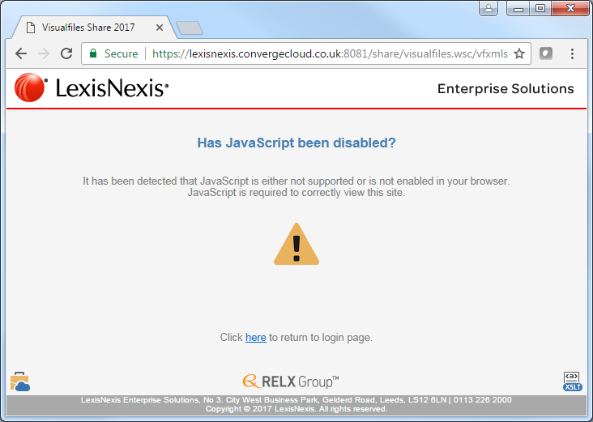
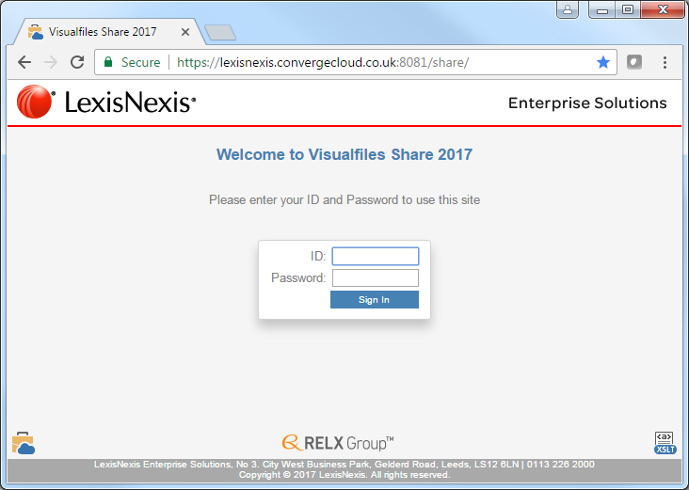
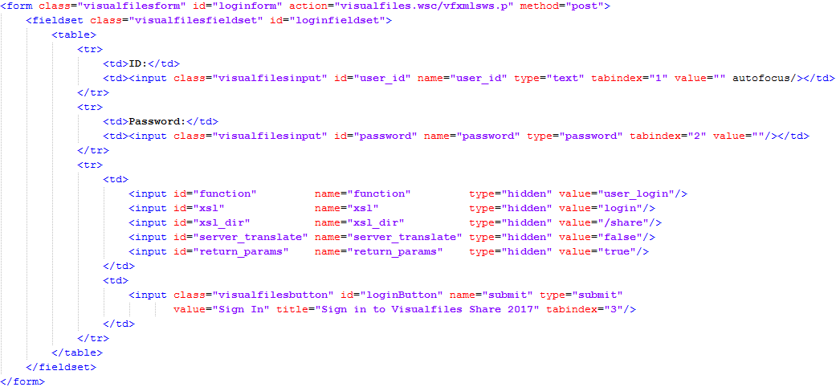
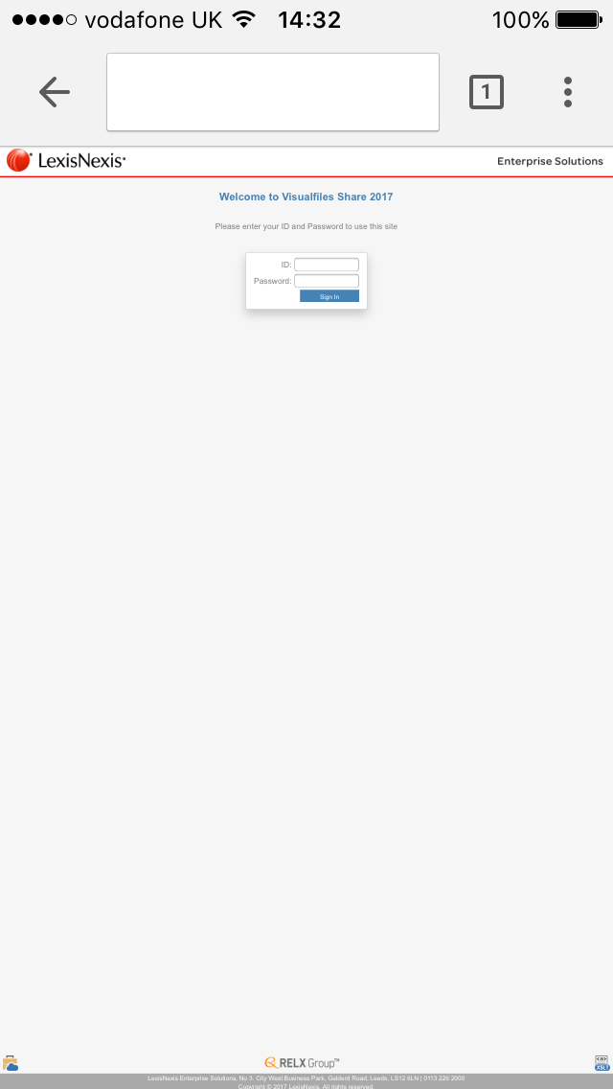
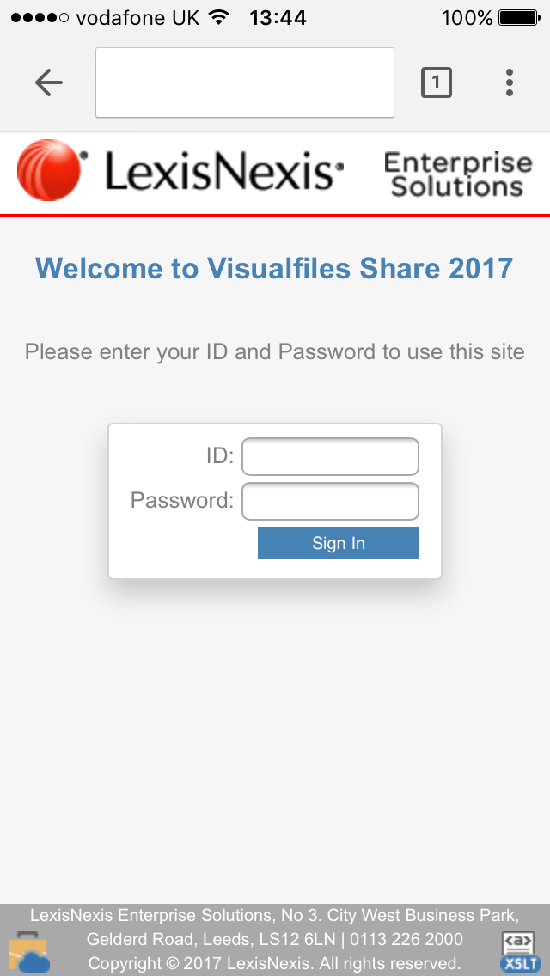
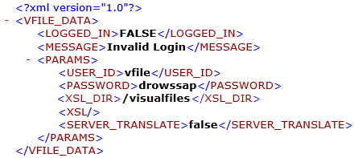
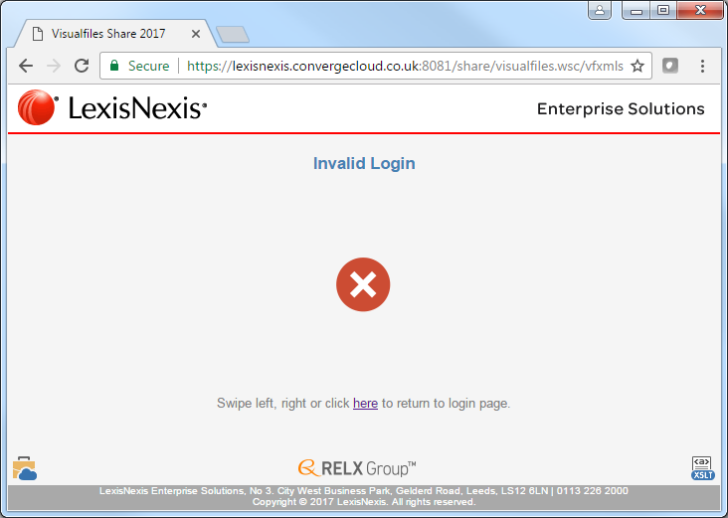
Example Application – Code Snippets - Login
Notes:
Looking at some of the code highlights, starting with login:
Setting the viewport to scale the page – otherwise we end up with a difficult to use login page on an iPhone – when what we really want is zoomed in.
Three stylesheets – a base css that has all standard definitions, a wide css that overrides the base when the browser is > 600 pixels and a mobile css that overrides the other two when the screen < 600 pixels
A couple of icon references – one allows an image to be used on apple devices when bookmarked and the other an image to appear in the browser tab.
In the header section I have added a noscript entry to redirect to a page should javascript be disabled.
Then a quick look at the form that displays the login box – when we press “login” it calls Visualfiles and waits for an XML response.
In that response is a flag indicating if the userid/password was accepted. When FALSE returned, we navigate to an invalid login page.

Slide 22
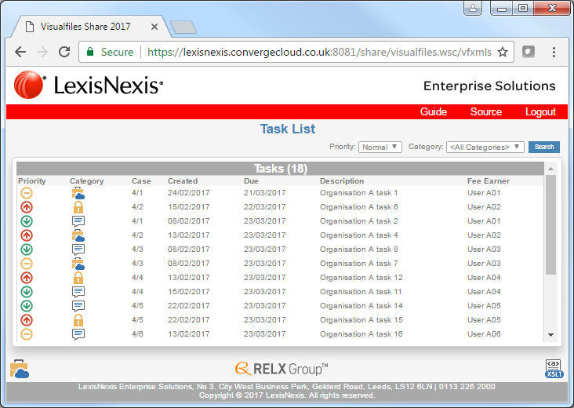
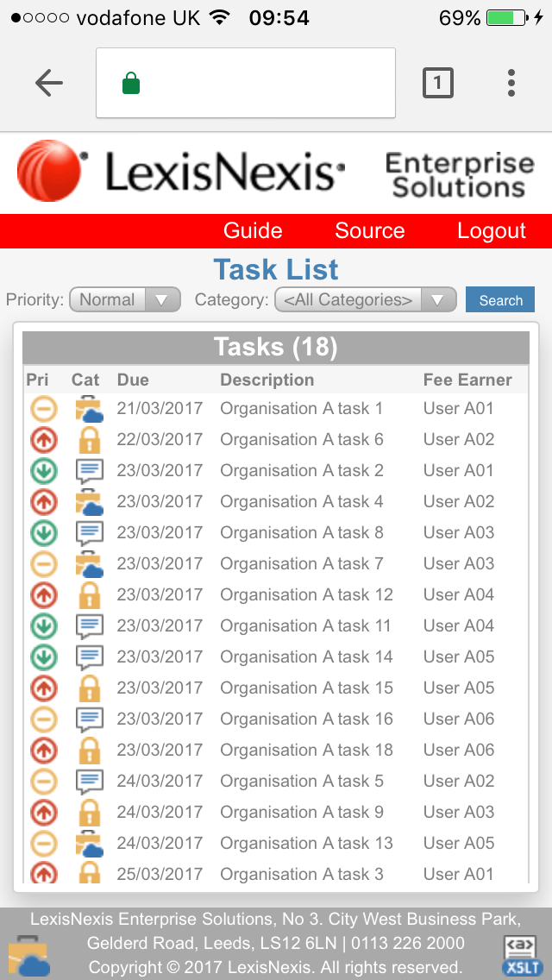
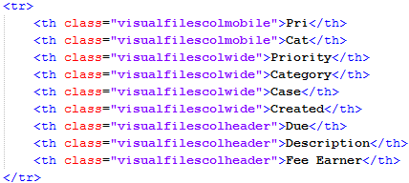
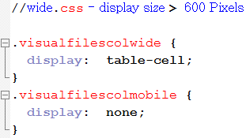
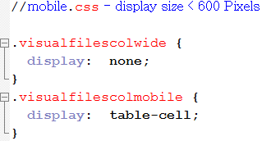
Example Application – Code Snippets – To Do List
Notes:
The task list is a good example of a dynamic screen, the grid changes based on screen width. For a wide screen we get 7 columns. A small screen, such as a mobile removes the case code and date created and changes the Priority and Category column labels to 3 characters each.
The HTML behind that is pretty simple. The PRI and CAT column headers are given a class “visualfilescolmobile” which in the wide css is defined as “display none” (hidden) but in the mobile css a “display table-cell” to make visible.
The next 4 column headers are given a class “visualfilescolwide” which in the wide css is defined as “display table-cell” (visible) but in the mobile css a “display none” to make hidden.

Slide 23
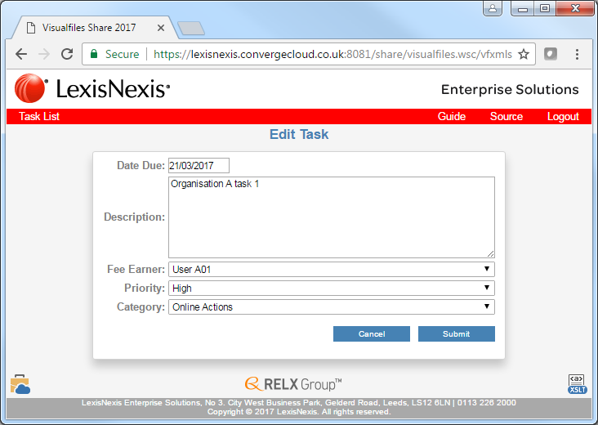
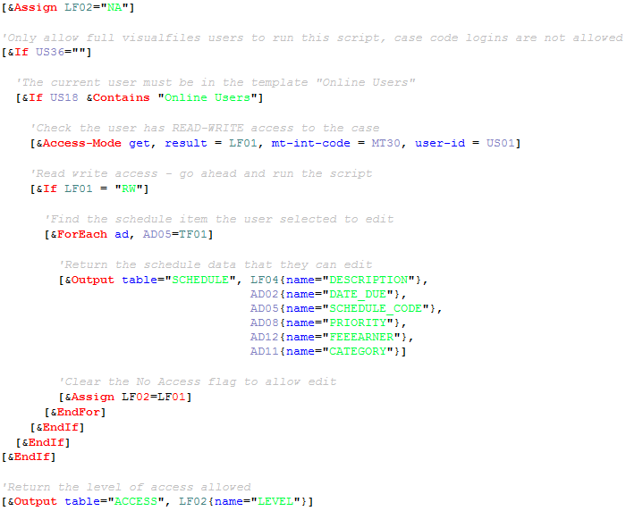
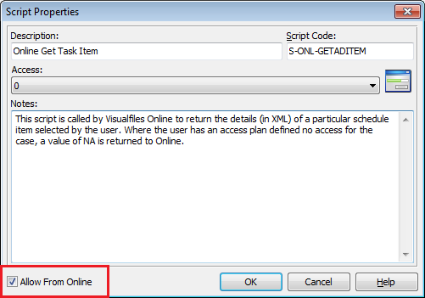
Example Application – Code Snippets – Edit To Do Item
Notes:
After clicking on an item in the grid the application makes a call to Visualfiles to run a System Script. When that script was created its flag was set to allow access from online. The script contains:
A field defined with value NA to represent No-Access. Should any of the criteria in the logic fail, the last line of the script sends back to the web page the value of the field – NO-ACCESS and the user is warned.
It then tests the value of US36 – new field, if blank it’s a full login otherwise its value is the case code used to login. This script only executes when invoked by full users.
We then test for access plans. Users must have full access to the case in order to edit the schedule item.
If all this criteria met, we lookup the schedule item selected, return the details in the XML and then clear the no-access flag to let the web page proceed allowing the user to edit the details.

Slide 24
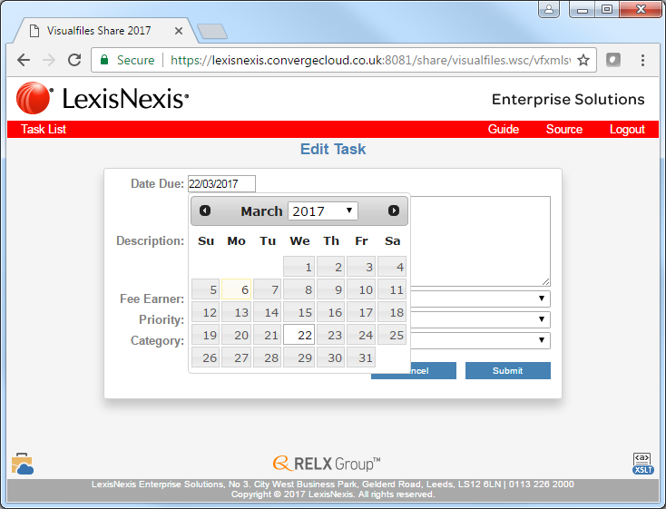
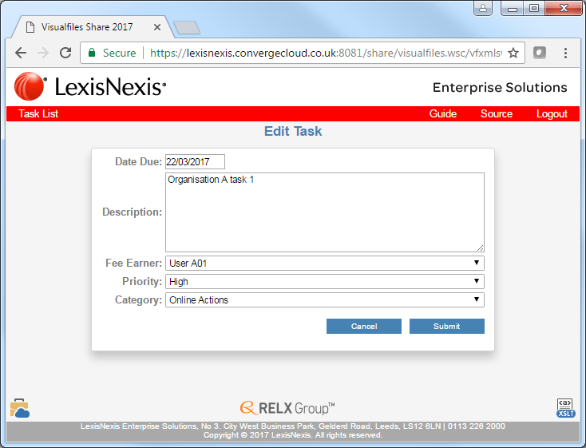
Example Application – Code Snippets – Date Input
Notes:
Spoke earlier about cross browser support – using date input as an example.
Here we have an input field for date due. Instead of using HTML5 date type, use a freely available component from jquery.
It’s a set of libraries you can download and host from your own site or you can connect to the cloud hosted version – either from Microsoft cloud or google – here we go with the google hosting. Once references are made it’s a simple few lines of code to embed within your own pages.

Slide 25
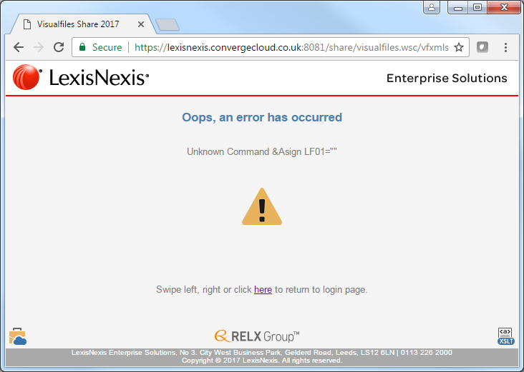
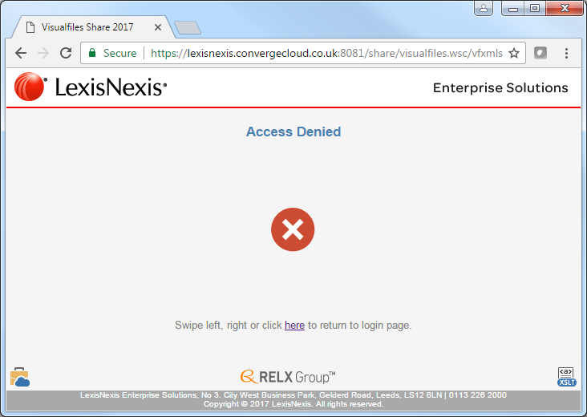
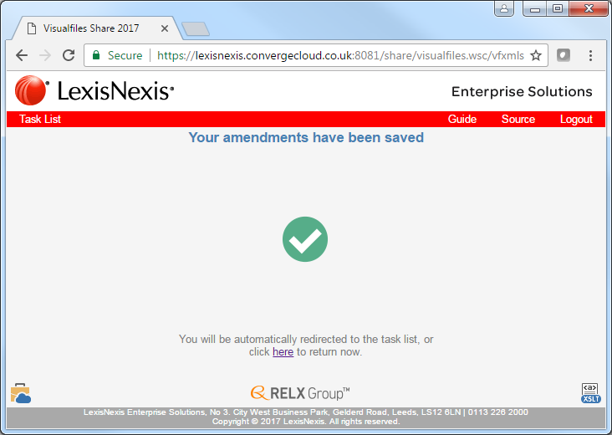
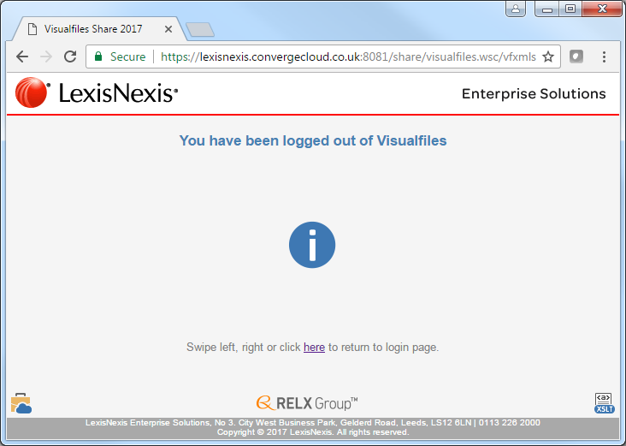
Example Application – Code Snippets – XSL Includes
Notes:
Moving on to the common look and feel – I have used XSL includes along with the CSS to ease future maintenance and ensure a consistent appearance across the application…

Slide 26
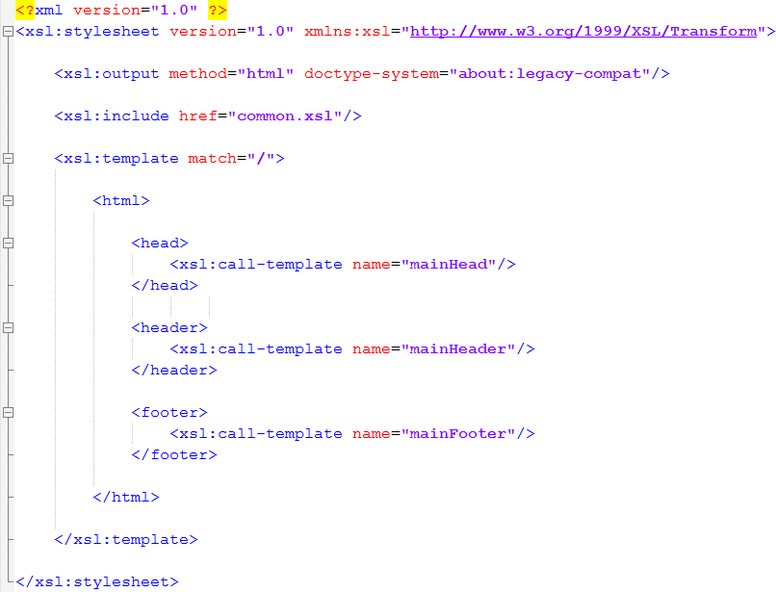
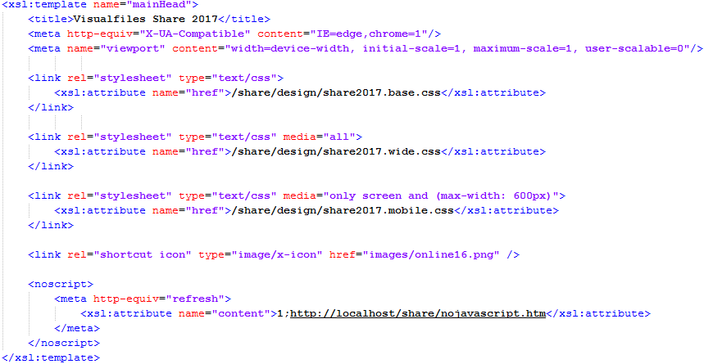
Example Application – Code Snippets – XSL Includes
Notes:
Looking at the template for each of my pages…
At the top of the page I reference the include file – making its contents available to the page.
I then import a standard HEAD block from the include – this sets the auto-scaling, stylesheets and performs the nojavascript check.
I then import a standard HEADER which includes the Lexis and ES logos and sets the hyperlinks.
Finally I import a standard FOOTER which brings in the address, contact and copyright notice that appears at the bottom of the page.
The actual include file has other blocks that manage the menu bar and page redirections. Download the source to see more.

Slide 27
Agenda
What is Visualfiles Online?
Why Build An Online Solution
Example Application
Important Considerations
Enterprise Solutions
Notes:
A look at an example application using many of the topics discussed so far …

Slide 28
Important Considerations
Technology choices
Visualfiles Online is technology agnostic
Any tool posting HTTP and process XML response
Enterprise Solutions
Notes:
Online does not mandate a particular technology.
In reality it receives instructions in the form of HTTP requests
It responds with data packaged as XML
Any technology that meets those requirements can be used.

Slide 29
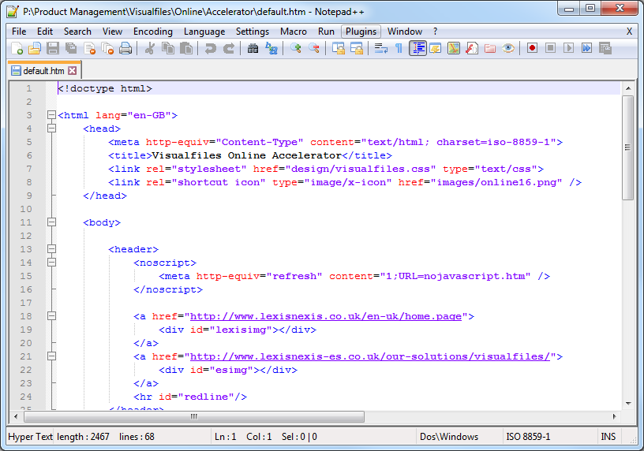
Important Considerations
Technology choices
XSLT and JavaScript
Very popular technology
Simple to learn, develop and maintain
Skills readily available
Low cost infrastructure
Enterprise Solutions
Notes:
The most popular framework is XSLT and JavaScript. But it’s not mandatory!
It’s well established but its age shouldn’t be a blocker.
Very easy to learn – existing IT resource should be capable
External consultants readily available
Low cost infrastructure – I use free editor notepad plus plus

Slide 30
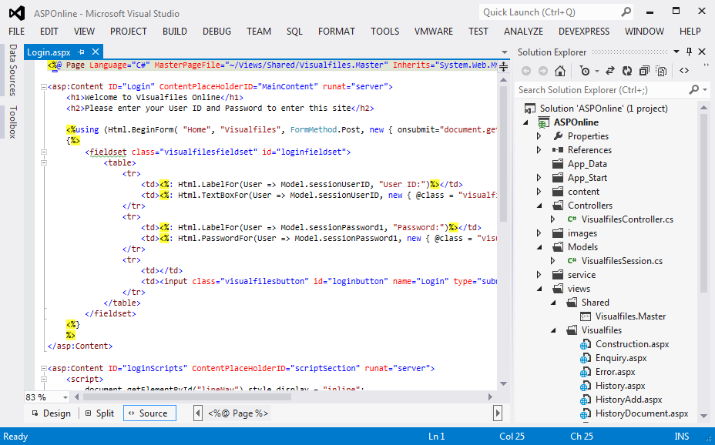
Important Considerations
Technology choices
ASP and MVC
Full power of the .Net stack
Advanced capabilities
Increased skill set
Visual Studio Infrastructure
Enterprise Solutions
Notes:
The obvious alternative is
ASP.Net using Model View Controller framework.
Some say – “more modern approach” (modern does mean better)
Full advanced capabilities of .Net
Might be necessary where more complex requirements
It does require an increase in skill set – hard-core programming.
It requires a more advanced infrastructure – Visual Studio.
Which one?
If you are building routine web application (for pc, mobile, table) and you don’t have Visual Studio or ASP skills – go with XSL. It will absolutely do the job and get you live quickly.
If you already have Visual Studio and ASP skills, go with that.
Don’t think XSL is a bad choice because its been around a while!

Slide 31
Important Considerations
Security Options
Restricted Entities – access specific entities and their cases
Access Plans – specify read-only, no-access or full access to cases
Case Passwords – allows direct online login to a single case
Script Lockdown – specify if a script can be run from online
Enterprise Solutions
Notes:
We will explore some of these in more detail later, but …
Restricted entities allow a user to be associated with one or more entity. This restricts them to access only those entities and the cases belonging to those entities.
Access Plans allow you to set the level of access a user has to specific cases – read-write, read-only or no-access. Many of the online functions will exclude results for cases with no-access.
Case Passwords – allows direct login to that case without having a full VF user account.
Scripts can be blocked from online access. Good practice to block everything that is known to be for use in your main VF system and never intended to be executed by online.

Slide 32
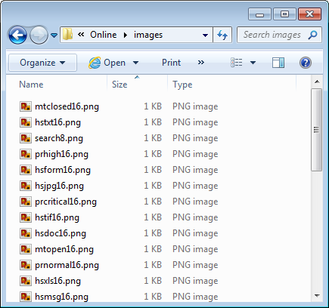
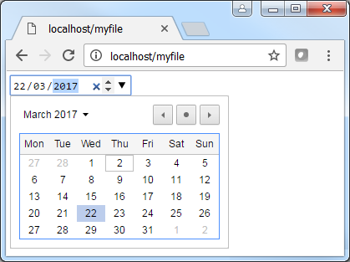
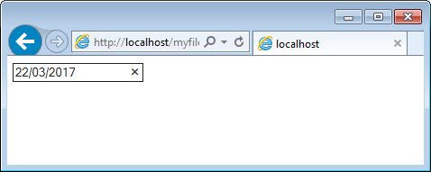
Important Considerations
Device Capabilities
Limitations of screen sizes
HTML5 Cross Browser Support
Connection Speeds
Enterprise Solutions
Notes:
When planning an application …
Spend a little time understanding how different devices behave. Some devices can scale pages (if configured) which gives a much better user experience. It’s simple to do – one line of HTML. We will see shortly.
Understand that what works in one browser doesn’t necessarily work the same in others.
For example a simple date input field. HTML5 provides a standard for showing a date picker to simplify date input and ensure only valid dates entered. If you run this on Chrome you get what you expect. If you run on IE the same page doesn’t.
Factor such things into your application to ensure your application works consistently across browsers.
We will see an example of dates shortly.
Be mindful of users who may not have gigabit hardwired network connections or maybe run with a metered mobile data connection. Reduce the impact on them – minimise file sizes (images).

Slide 33
Important Considerations
Future Maintenance
How easy will it be to…
Apply branding changes
Update copyright notices
Update contact information
Use of CSS and XSL Include Files
Enterprise Solutions
Notes:
Think about maintaining your application going forward. You will likely need to
Make changes to your branding – logos, colours and hyperlinks change often.
Copyright notices change each year
Your contact information – phone number and address can change
These details are usually visible on multiple pages (if not all) within your application. If you hardcode into every page it becomes a challenge to update and keep everything in synch.
Instead investigate the use of XSL Include files that allow you to define blocks of code (perhaps a standard header and footer) which can then be included into each of your application pages. When a change is required, do it once in the include file and it is automatically reflected in all pages.
CSS is very powerful and makes it very easy to adopt standard fonts, colours and styles. They help provide a dynamic interface that can change based on the size of the screen.

Slide 34
Summary
“A toolkit allowing the creation of Visualfiles applications delivered securely over the internet.”
https://lexisnexis.convergecloud.co.uk:8081/share/
Useful Resources …
Lexis Visualfiles Online Command Reference
Lexis Visualfiles Online Accelerator Guide and Project
https://www.w3schools.com/ and http://stackoverflow.com/
Notes:
It’s a toolkit to allow creation of vf apps delivered securely over internet.
Here is the URL for the example app for you to login using the credentials provided – go have a play, download the source and the guide.
Some other useful stuff can be found – we have a fully updated reference guide for Online, another example app known as the accelerator and for help building HTML, go look at the websites.

Slide 35
Summary
https://lexisnexis.convergecloud.co.uk:8081/share/

