Slide 2
Enterprise Solutions

Slide 3
Marcus Hutchinson
Building Solutions with Visualfiles Online
Enterprise Solutions

Slide 4
Agenda
What is Visualfiles Online?
Why Build An Online Solution
Example Application
Important Considerations
Enterprise Solutions

Slide 5
Agenda
What is Visualfiles Online?
Why Build an Online Solution
Example Application
Important Considerations
Enterprise Solutions

Slide 6
What is Visualfiles Online?
“A toolkit allowing the creation of Visualfiles applications delivered securely over the internet.”

Slide 7
What is Visualfiles Online?
A Visualfiles service on the web
Receives instructions as HTTP requests
Responds with information packaged as XML
Allows access to Visualfiles from any compatible device
Simple set of function calls to standard Visualfiles objects

Slide 8
What is Visualfiles Online?
A Visualfiles service on the web
Invoke system scripts, search, retrieve and update data
Upload and download documents
Honour the Visualfiles security model

Slide 9
Agenda
What is Visualfiles Online?
Why Build an Online Solution
Example Application
Important Considerations
Enterprise Solutions

Slide 10
Why Build An Online Solution
Provide alternate user interfaces:
For specific tasks or processes that benefit from bespoke interfaces
Dynamically changing forms
To deploy one solution across multiple brands
To address specific usability issues
Avoid the 30 field limit
Enterprise Solutions

Slide 11
Why Build An Online Solution
Remote access:
Access live system from any location
Time Recording
Manage To-Do List
Connect using any compatible device
iPhone/iPad
Android Phone/Tablet
Case Tracker
Document Review
Chrome/Safari/IE/Edge
Mac/PC
Enterprise Solutions

Slide 12
Why Build An Online Solution
Self-service:
B2C: Client portal secure access to specific case
Review progress
Download/Upload documents
B2B: Self-service for agents, experts and work providers
Create new case
Drive workflow
Submit instructions
Record fees
Generate quotes
Enterprise Solutions

Slide 13
Agenda
What is Visualfiles Online?
Why Build An Online Solution
Example Application
Important Considerations
Enterprise Solutions

Slide 14
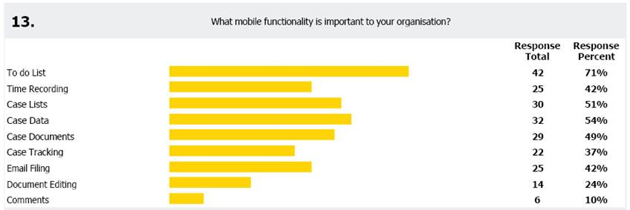
Example Application
Share 2016
What mobile functionality is important to your organisation?

Slide 15
Example Application
Simple view of “your” organisations task list
Select a task and edit details
Date Due (date picker)
Fee Earner (selection list)
Description (notes box)
Priority (selection list)
Category (selection list)

Slide 16
Example Application
Security
Multiple organisations
Restricted entities
Obfuscated URL
Handler mappings
HTTP Post

Slide 17
Example Application
Usability
Dynamic interface based on screen size
Consistent interface across device
Not all devices and browsers behave the same
Architecture
Use of XSL Includes
Error handling built into every page

Slide 18
Example Application - Security
User A01
User A06
User B01
User B06
Organisation A
Global Entity
Organisation B
Case A01
Case A06
Global Case
Case B01
Case B06
Schedule Items
Source Code and Guide
Schedule Items

Slide 19
Example Application
Demonstration

Slide 20
Example Application
Technology Stack

Slide 21
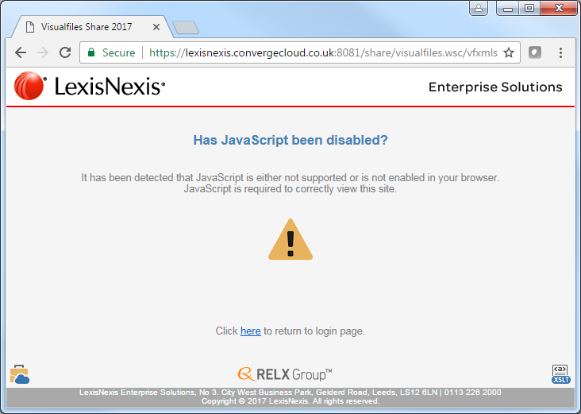
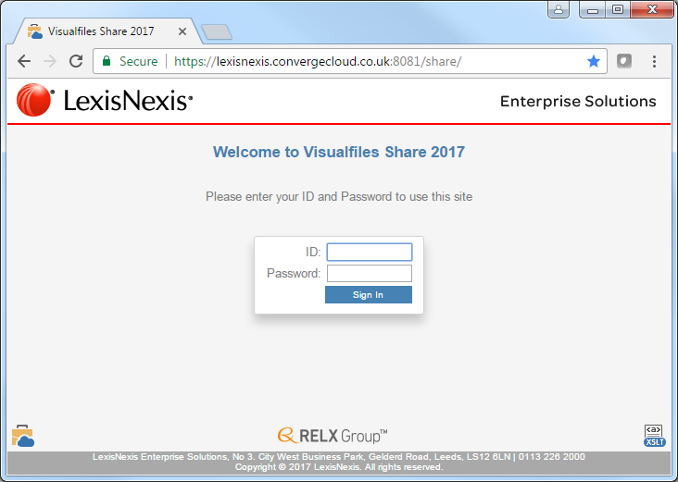
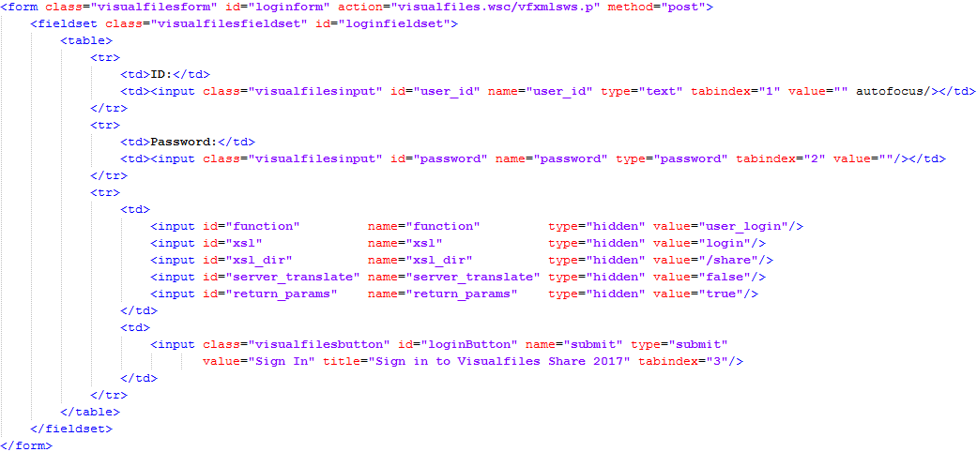
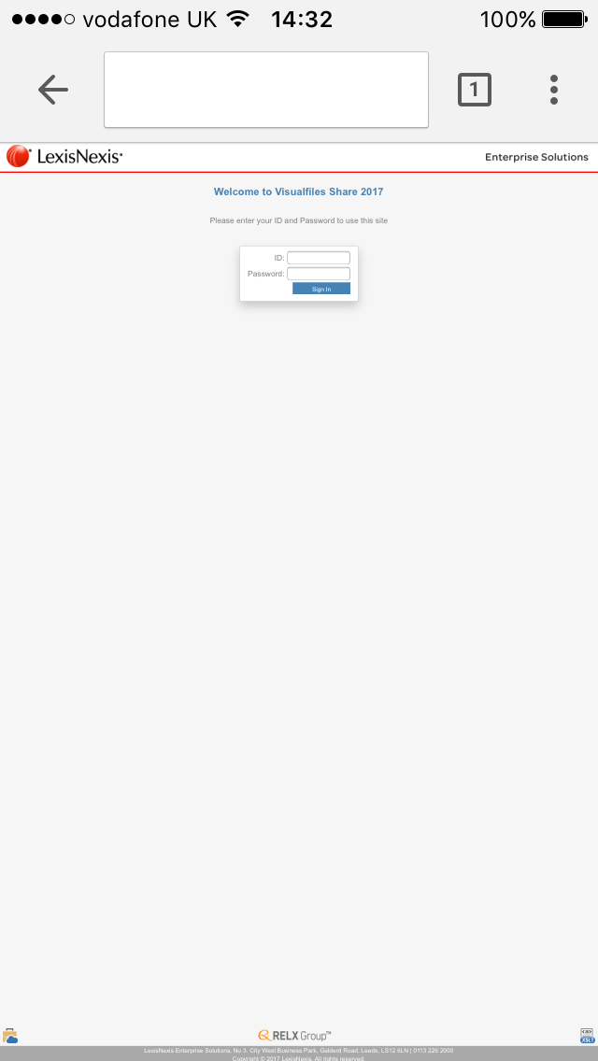
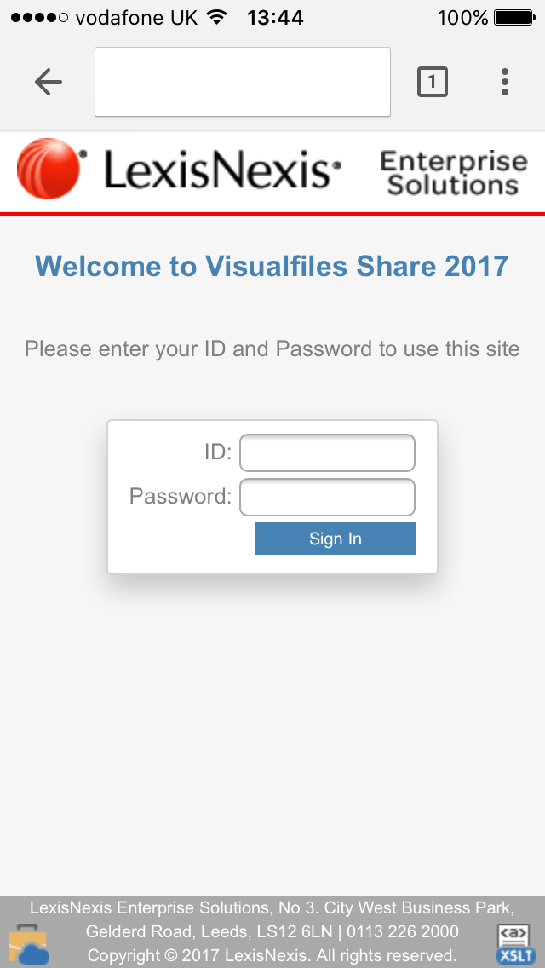
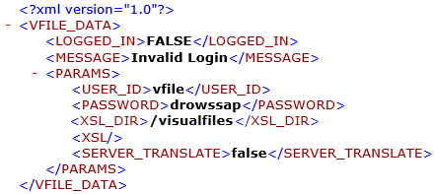
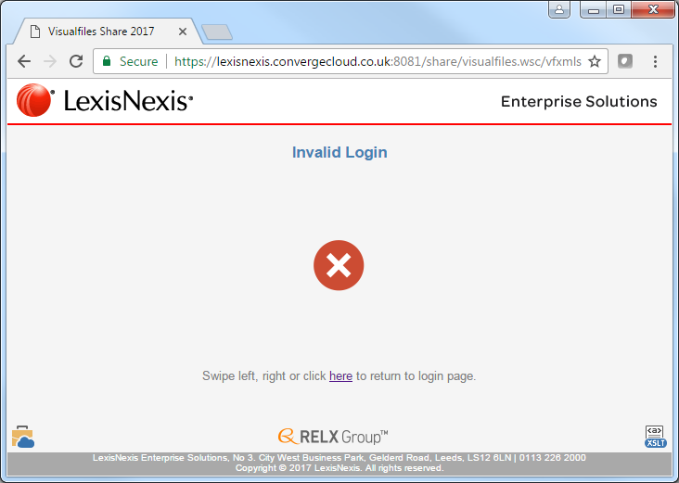
Example Application – Code Snippets - Login

Slide 22
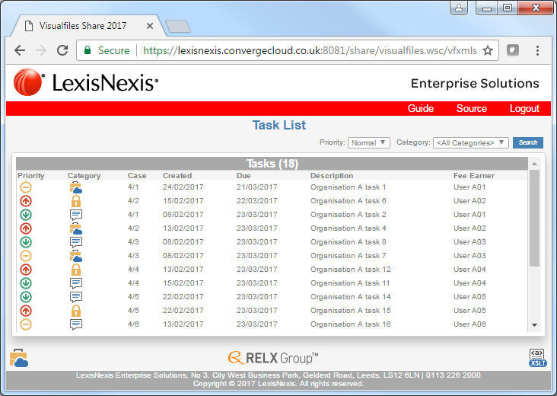
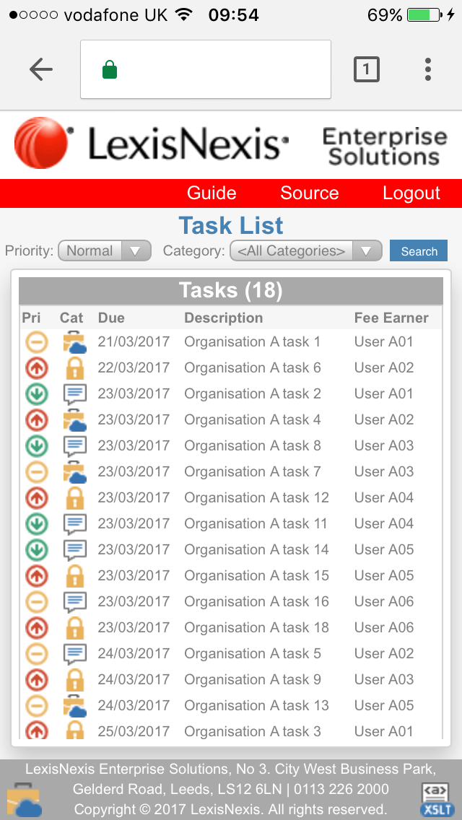
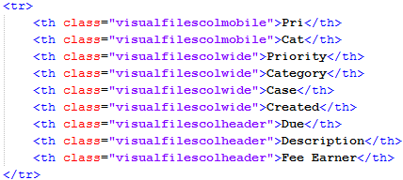
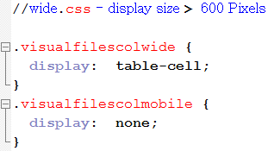
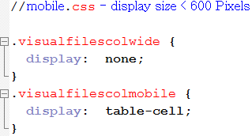
Example Application – Code Snippets – To Do List

Slide 23
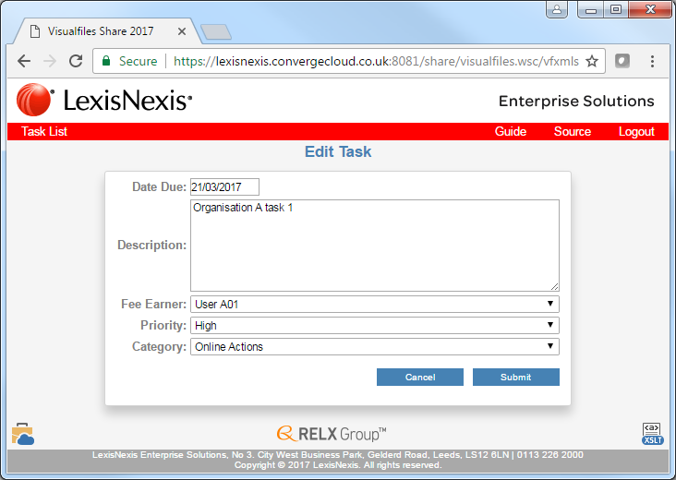
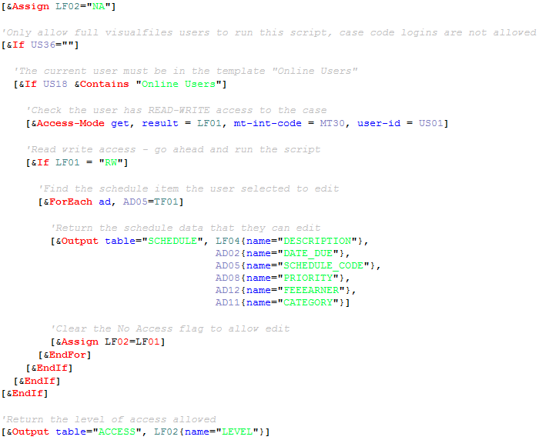
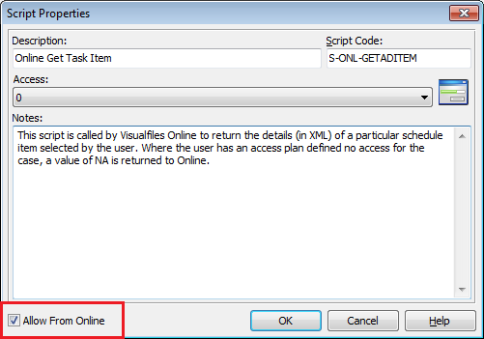
Example Application – Code Snippets – Edit To Do Item

Slide 24
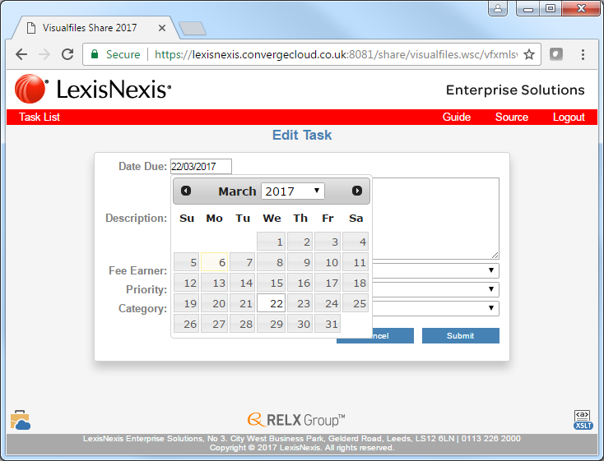
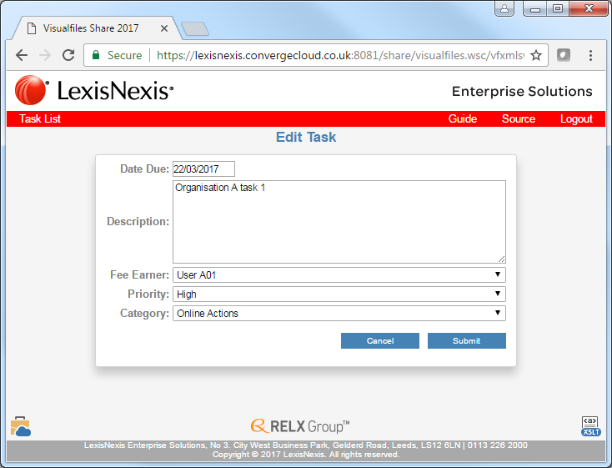
Example Application – Code Snippets – Date Input

Slide 25
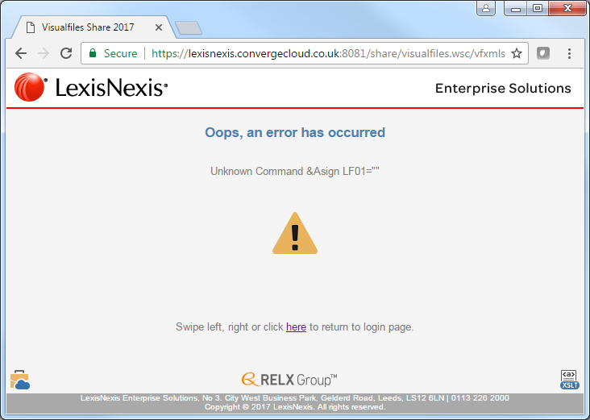
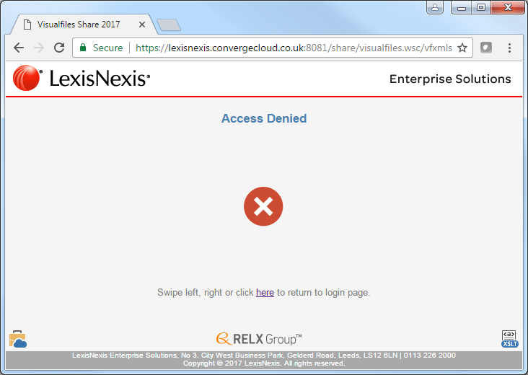
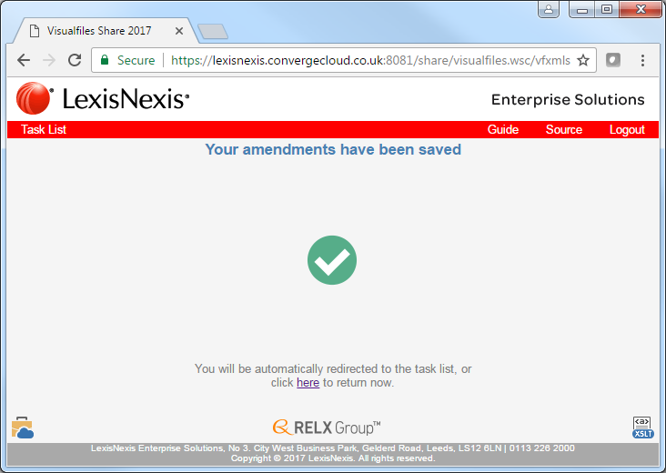
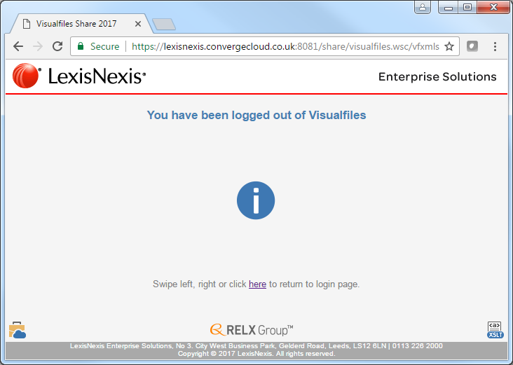
Example Application – Code Snippets – XSL Includes

Slide 26
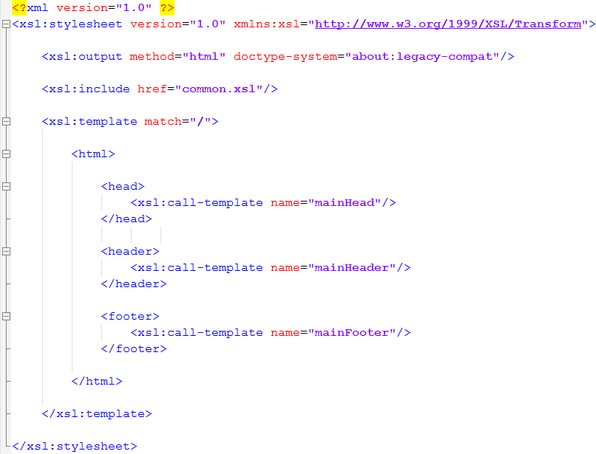
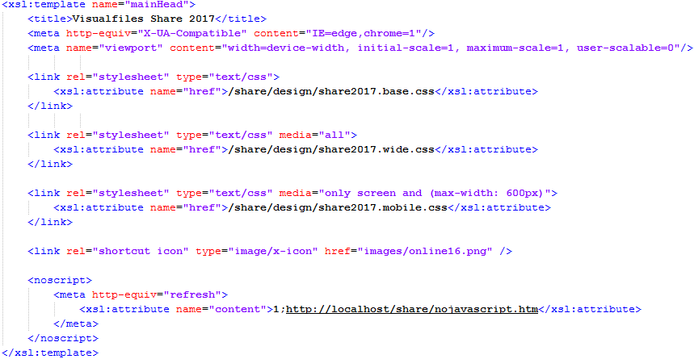
Example Application – Code Snippets – XSL Includes

Slide 27
Agenda
What is Visualfiles Online?
Why Build An Online Solution
Example Application
Important Considerations
Enterprise Solutions

Slide 28
Important Considerations
Technology choices
Visualfiles Online is technology agnostic
Any tool posting HTTP and process XML response
Enterprise Solutions

Slide 29
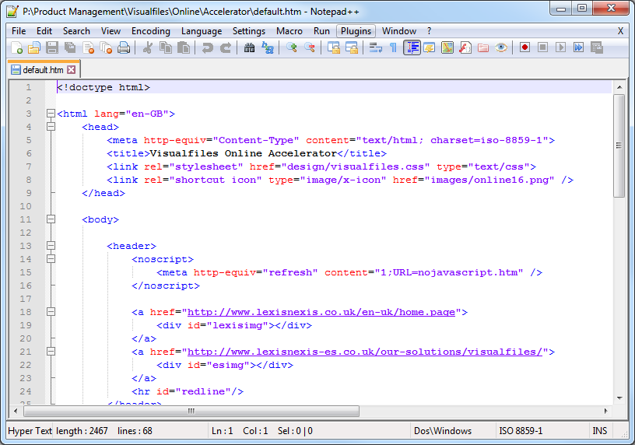
Important Considerations
Technology choices
XSLT and JavaScript
Very popular technology
Simple to learn, develop and maintain
Skills readily available
Low cost infrastructure
Enterprise Solutions

Slide 30
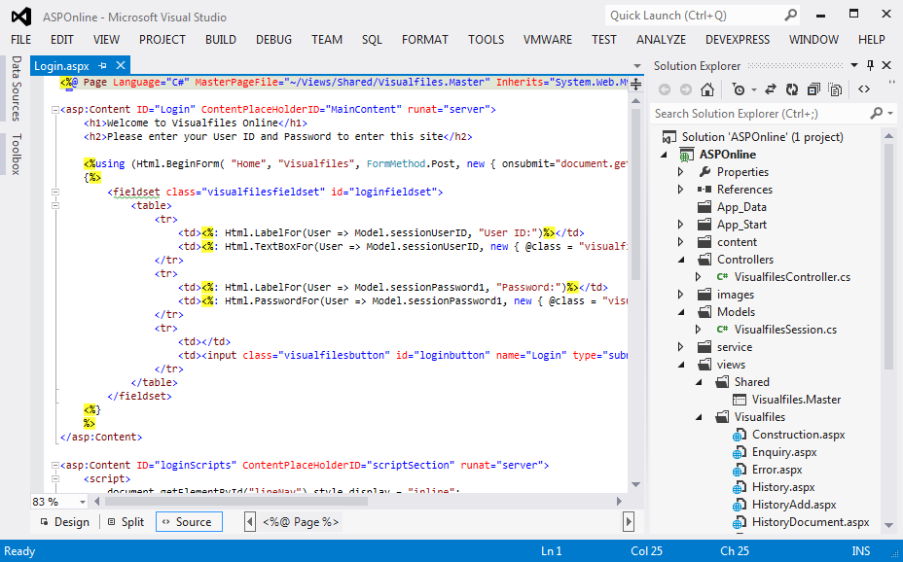
Important Considerations
Technology choices
ASP and MVC
Full power of the .Net stack
Advanced capabilities
Increased skill set
Visual Studio Infrastructure
Enterprise Solutions

Slide 31
Important Considerations
Security Options
Restricted Entities – access specific entities and their cases
Access Plans – specify read-only, no-access or full access to cases
Case Passwords – allows direct online login to a single case
Script Lockdown – specify if a script can be run from online
Enterprise Solutions

Slide 32
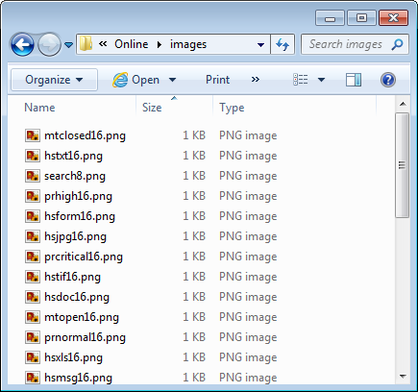
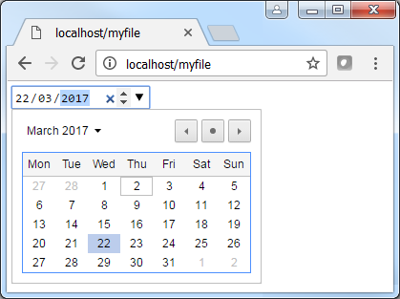
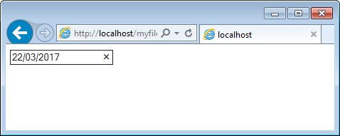
Important Considerations
Device Capabilities
Limitations of screen sizes
HTML5 Cross Browser Support
Connection Speeds
Enterprise Solutions

Slide 33
Important Considerations
Future Maintenance
How easy will it be to…
Apply branding changes
Update copyright notices
Update contact information
Use of CSS and XSL Include Files
Enterprise Solutions

Slide 34
Summary
“A toolkit allowing the creation of Visualfiles applications delivered securely over the internet.”
https://lexisnexis.convergecloud.co.uk:8081/share/
Useful Resources …
Lexis Visualfiles Online Command Reference
Lexis Visualfiles Online Accelerator Guide and Project
https://www.w3schools.com/ and http://stackoverflow.com/

Slide 35
Summary
https://lexisnexis.convergecloud.co.uk:8081/share/

