Slide 2
Enterprise Solutions

Slide 3
Sandra Wayman
Tips, Tricks and Techniques
Enterprise Solutions

Slide 4
Enterprise Solutions

Slide 5
Efficient Scripting
&CONFLICT… begins vs contains
&SUB vs &CALL
Enterprise Solutions

Slide 6
Efficient Scripting
Calling script: | Called script:
[&UserInput prompt="Enter your name",result=LF01] [&Call SYSTEM.CALL3,input=LF01,output=LF02] [&Message "Hello "+LF02] | [&Assign LF01=PI01] [&Assign LF02=LF01:char(first=1,number=1):caps] [&Assign LF03=LF01:char(first=2,number=999):lc] [&Assign PO01=LF02+LF03]
Enterprise Solutions

Slide 7
Efficient Scripting
Calling script: | Called script:
[&UserInput prompt="Enter your name",result=LF01] [&Call SYSTEM.CALL3,input=LF01,output=LF02] [&Message "Hello "+LF02] | [&Assign LF01=PI01] [&Assign LF02=LF01:char(first=1,number=1):caps] [&Assign LF03=LF01:char(first=2,number=999):lc] [&Assign PO01=LF02+LF03]
Script with subroutine:
[&UserInput prompt="Enter your name",result=LF01] [&Call hello,input=LF01,output=LF02] [&Message "Hello "+LF02] [&Sub hello] [&Assign LF01=PI01] [&Assign LF02=LF01:char(first=1,number=1):caps] [&Assign LF03=LF01:char(first=2,number=999):lc] [&Assign PO01=LF02+LF03] [&EndSub]
Enterprise Solutions

Slide 8
Efficient Scripting
LF01 vs ABC01
Do | Don’t
[&Assign LF01 = ""] [&ForEach ABCG] [&Assign LF01 = LF01 + ABC01] [Endfor] [&Assign XYZ01 = LF01] | [&Assign XYZ01 = ""] [&ForEach ABCG] [&Assign XYZ01 = XYZ01 + ABC01] [&Endfor]

Slide 9
Efficient Scripting
OPEN/CLOSE script
HIDE script
Appserver
&FOREACH ABCG
&COUNT
&GRID action=“FILL”

Slide 10
Efficient Scripting
Traditional grid script:
[&Grid action="delete"] [&Grid action="create"] [&Grid action="create-col",name="Name",type="char",format="X(30)"] [&Grid action="create-col",name="Address",type="char",format="X(30)"] [&Grid action="create-col",name="Mobile",type="char",format="X(30)"] [&Grid action="create-col",name="Email",type="char",format="X(30)"] [&ForEach DEFE] [&Grid action="create-row"] [&Assign GR01=DEF03] [&Assign GR02=DEF15] [&Assign GR03=DEF18] [&Assign GR04=DEF20] [&EndFor] [&Grid action="display"]

Slide 11
Efficient Scripting
&GRID action=“fill”
[&Grid action="delete"] [&Grid action="create"] [&Grid action="FILL",type="GROUP",code="DEFE", fields="DEF03;Name,DEF15;Address,DEF18;Mobile,DEF20;Email", formats="x(30),x(30),x(30),x(30)", datatypes="char,char,char,char"] [&Grid action="display"]

Slide 12
Monitoring Progress

Slide 13
&History
[&History "Share document";SHA01,call="S-CALL4",save]

Slide 14
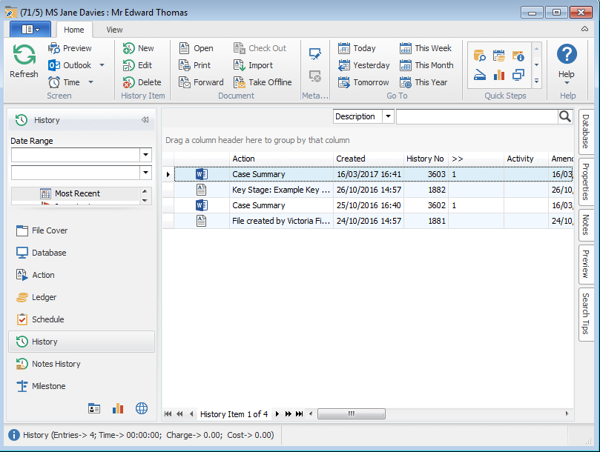
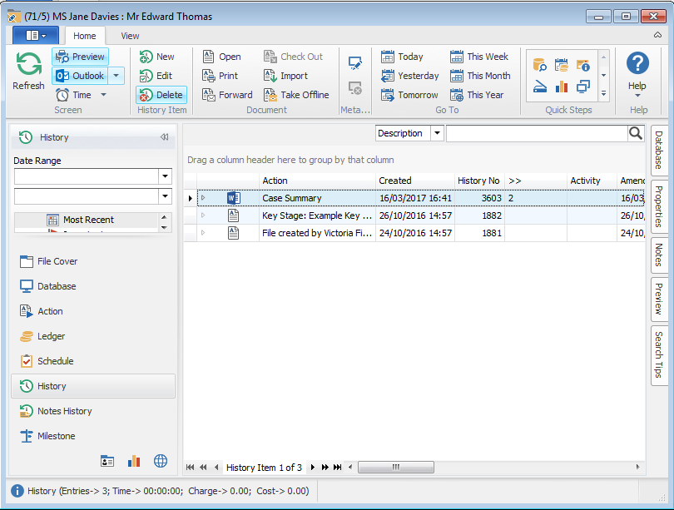
&History

Slide 15
Exporting and Importing History Documents
Run the document and save it to history as normal, noting its history id (HS26)
Where this is a second or subsequent run of the document:
Extract a copy of the document from the new history item to a temporary location on the network
Import the document copy into history as a new version against the original document’s history item
Delete the history item created for this run
Delete the copy of the document that was saved to the network

Slide 16
Exporting and Importing History Documents
Run the document and save it to history as normal, noting its history id (HS26)
Where this is a second or subsequent run of the document:
Extract a copy of the document from the new history item to a temporary location on the network
Import the document copy into history as a new version against the original document’s history item
Delete the history item created for this run
Delete the copy of the document that was saved to the network
[&GetDocument document={HS26}, filename={name of saved document}, directory={location to save document},overwrite, result=LF05

Slide 17
Exporting and Importing History Documents
Run the document and save it to history as normal, noting its history id (HS26)
Where this is a second or subsequent run of the document:
Extract a copy of the document from the new history item to a temporary location on the network
Import the document copy into history as a new version against the original document’s history item
Delete the history item created for this run
Delete the copy of the document that was saved to the network
[&GetDocument document={HS26}, filename={name of saved document}, directory={location to save document},overwrite, result=LF05
[&Select hs, history-no={HS26}] *** Get the original history item [&History ,read={path and file name of document to import},docid=HS24,versions,auto-save]

Slide 18
Tips, Tricks and Techniques
Sandra Wayman
sandra.wayman@lexisnexis.co.uk
07818 427640

