Slide 1

The TEAM is the Ultimate Business Development Tool
DARRYL CROSS, MBA, PES
Chief Performance Officer, HighPer Teams

Slide 2
1968

Slide 3


Slide 4
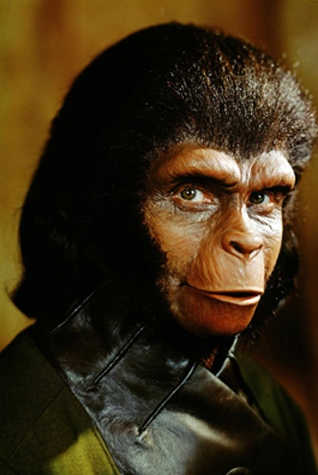
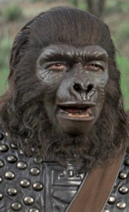

Slide 5
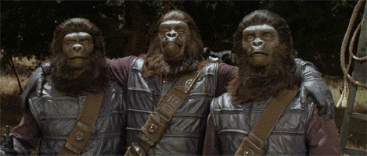
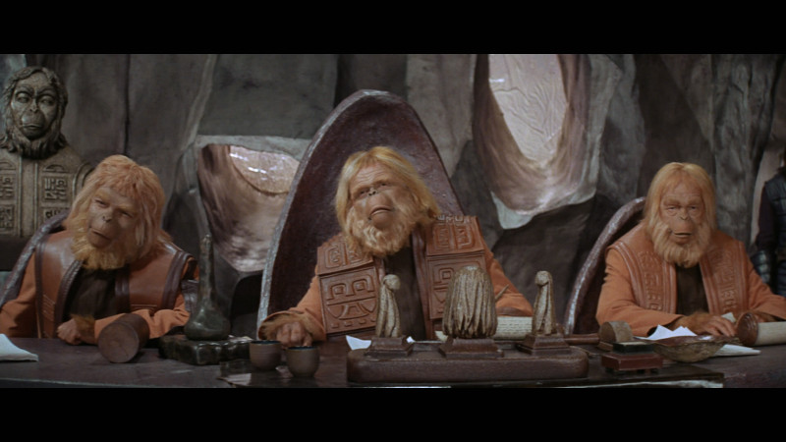
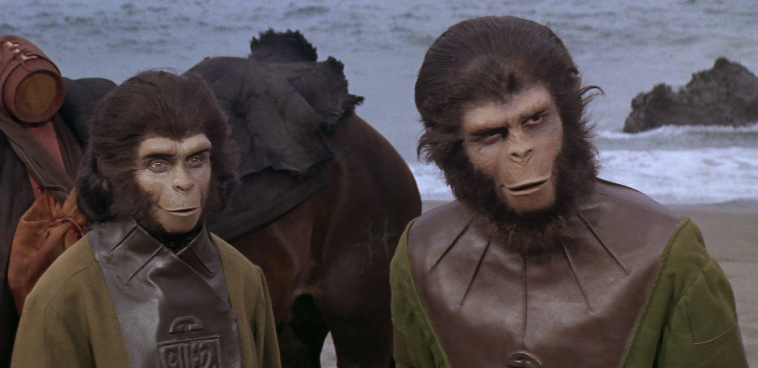

Slide 6
Today

Slide 7


Slide 8




Slide 9
TRIBALISM
Isolation leads to

Slide 10
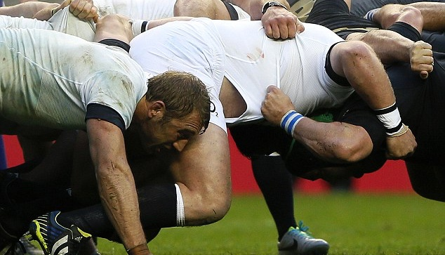
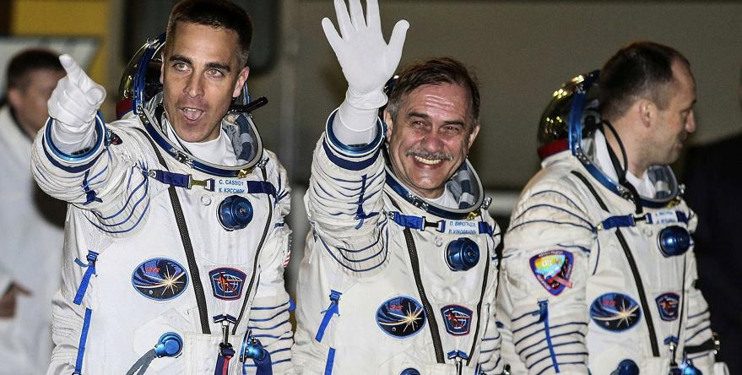



Slide 11
THE AGENDA FOR TODAY
THE CHALLENGE
CLIENTS ARE CHANGING FASTER THAN WE ARE ADAPTING WHILE WE ARE CLINGING TO PERSONAL COMFORTS AND PREFERENCES
TEAMS UNLEASH POTENTIAL
THE ELITE PLAN, PREPARE AND PERFORM AS TEAMS. THERE ARE NO EXCEPTIONS.
THREE BIG THINGS:
WHY ARE TEAMS NECESSARY?
WHAT MAKES A GREAT TEAM?
HOW DO YOU LEAD, COACH AND TRAIN THEM?
TAKEAWAYS

Slide 12
THE CHALLENGE
CLIENTS ARE CHANGING FASTER THAN WE
ARE ADAPTING WHILE WE CLING TO PERSONAL
COMFORTS AND PREFERENCES

Slide 13


Slide 14
BD TEAMS WE WILL EXPLORE
Onboarding teams
Performance pods
BD Skill Development
CLIENT/ACCOUNT TEAMS
INDUSTRY TEAMS
ISSUE AND INCIDENT TEAMS
CRISIS and response TEAMS
MERGER and expansion TEAMS
GROWTH AND PROSPERITY TEAMS

Slide 15
TAKEAWAY #1
Leadership is vision and guidance for everyone.
Coaching is a one-on-one activity.
Training should always be conducted in teams: before, during and after.

Slide 16
TEAMS UNLEASH POTENTIAL
THE ELITE PLAN, PREPARE AND PERFORM AS TEAMS.
THERE ARE NO EXCEPTIONS.

Slide 17
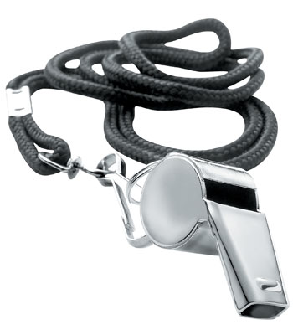
WHAT ARE TEAMS?

Slide 18
A team is a small number of people with complementary skills who are committed to a common purpose, set of performance goals and approach for which they hold themselves mutually accountable.
--Katzenbach and Smith, Harvard Business Review, Mar-Apr 1993

Slide 19
TEAM CENTRIC TRAINING WORKS. ASK THE ELITE.
MILITARY SPECIAL FORCES
Emergency dePTS
PRO ATHLETES
POLICE OFFICERS
FIRE SERVICES
FLIGHT DECK CREWS
FORMULA 1 PIT CREWS
ASTRONAUTS
SOFTWARE PROGRAMMERS
FIGHTER PILOTS

Slide 20
PROFESSIONAL SERVICE TEAMS
DEAL AND TRANSACTION TEAMS
LITIGATION TEAMS
MULTIDISCIPLINARY TEAMS
FEE EARNER SUPPORT TEAMS
INTERNAL OPERATIONS TEAMS
CRISIS TEAMS
MERGER AND ACQUISITION TEAMS
CLIENT TEAMS
INDUSTRY TEAMS

Slide 21
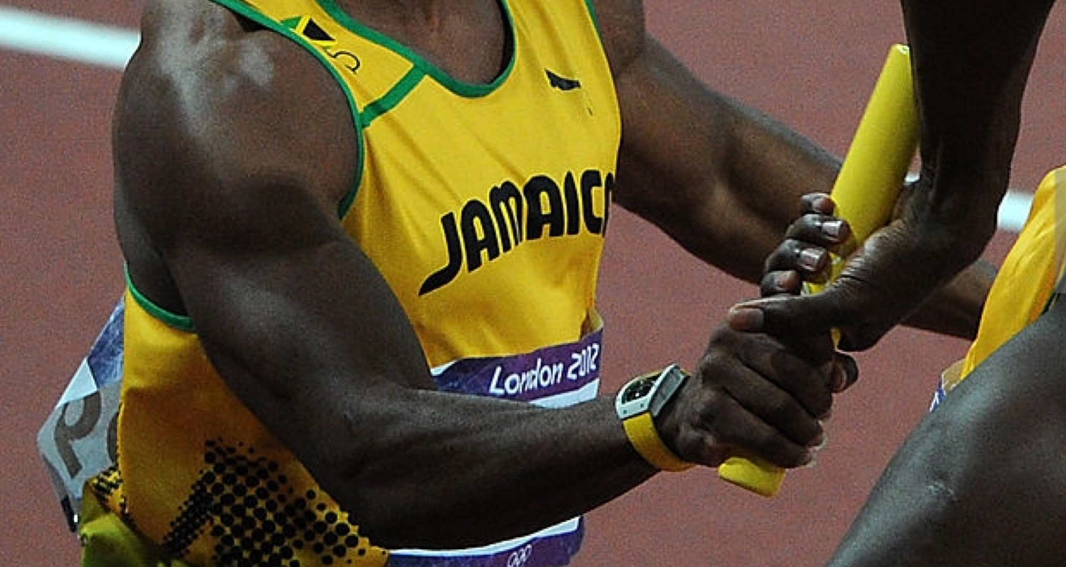

Slide 22
TAKEAWAY #2
You do not always need a team to solve a problem. They require high intensity of effort and can be overused.
Use teams when the stakes are high and you need people to get better at what they do every day.

Slide 23
THREE BIG THINGS:
WHY ARE TEAMS NECESSARY?
WHAT MAKES A GREAT TEAM?
HOW DO YOU LEAD, COACH AND TRAIN THEM?

Slide 24
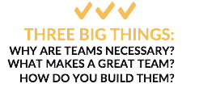
You can’t maximize individual performance without a team.
Great teams and groups of great people are not the same thing.
Teams require competency, accountability and trust.

Slide 25
WHY ARE TEAMS NECESSARY?

Slide 26


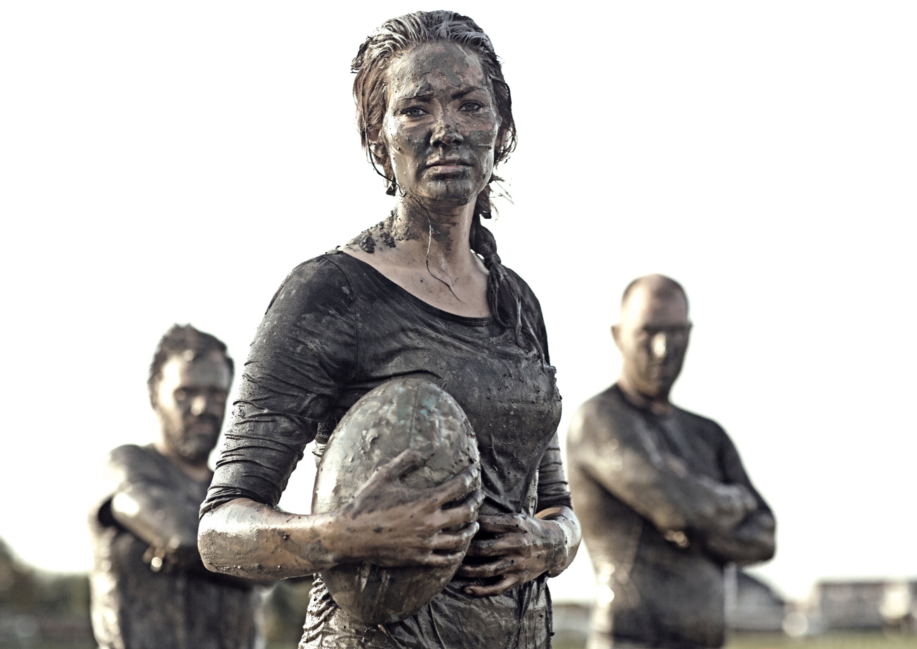
THE THREE KEYS TO HIGH PERFORMANCE
ART
—
Change your perspective.
See things differently.
Adapt and innovate.
SCIENCE
—
Innovation has its limits.
Accept what works.
Perfect it.
GRIT
—
You have resources, strategy, talent.
You have to do the work.
Power. Passion. Perseverance.

Slide 27
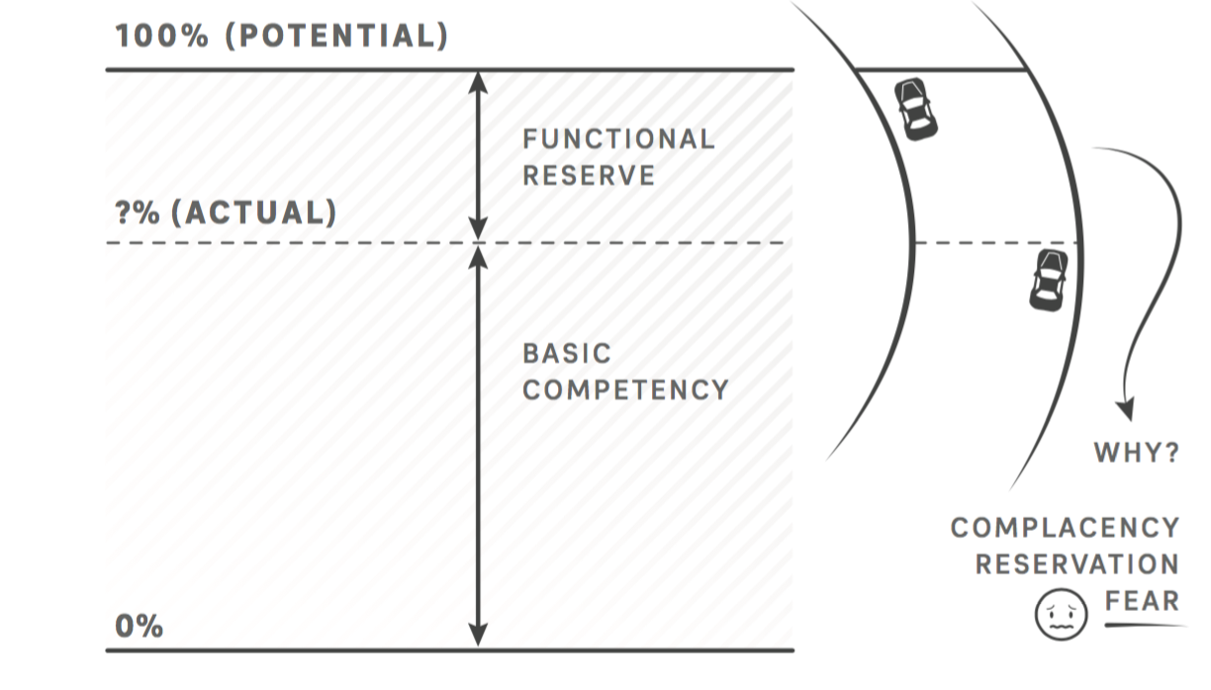
The Functional Reserve

Slide 28
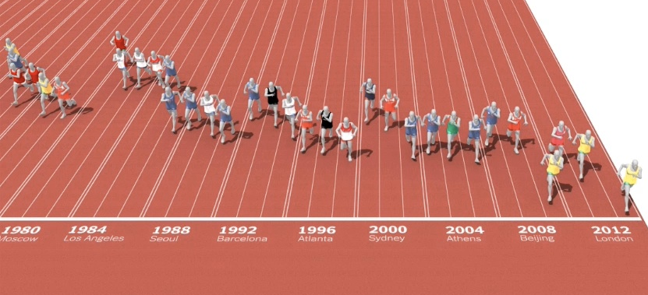
S
The line keeps moving
Source: “The Complete Book of the Olympics” by David Wallechinsky and Jamie Loucky

Slide 29
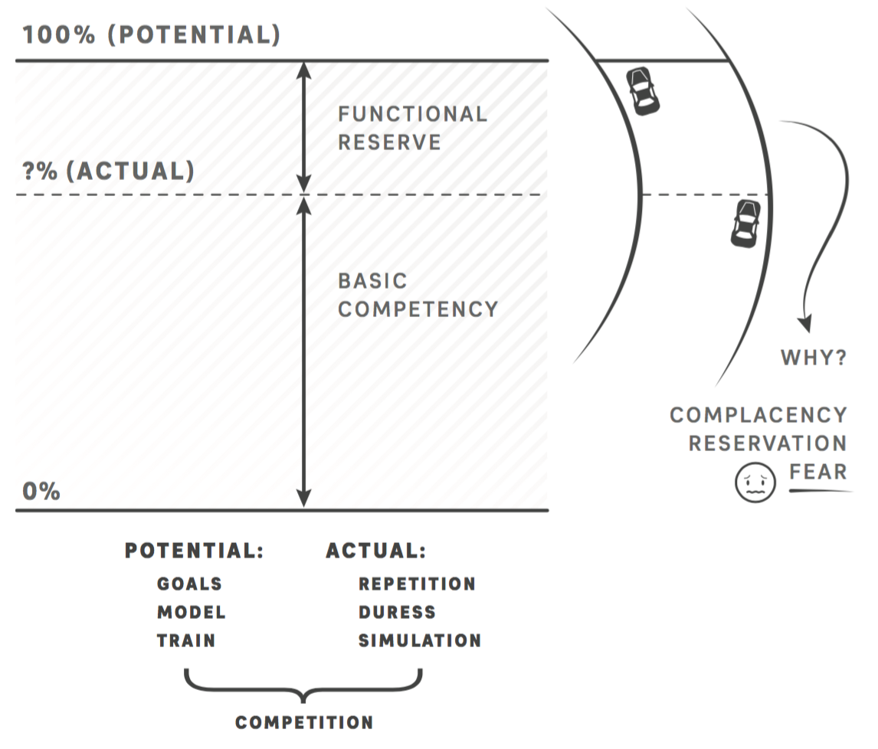
Tapping Into the Functional Reserve

Slide 30
TAKEAWAY #3:
USING DEVELOPMENTAL TEAMS
Onboarding teams
Performance pods
BD Skill Development

Slide 31
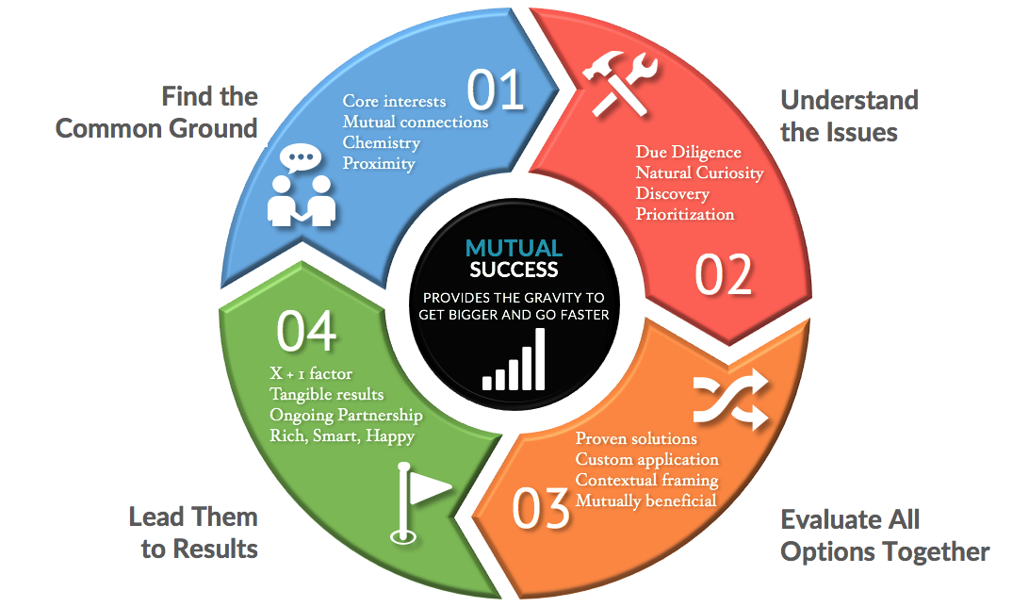
FUEL BD Training Model

Slide 32
WHAT MAKES A GREAT TEAM?

Slide 33
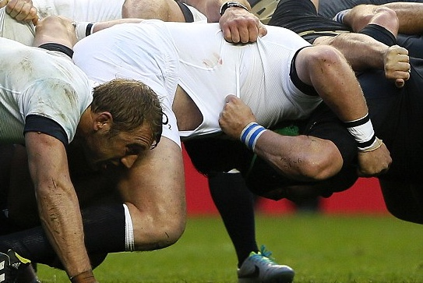
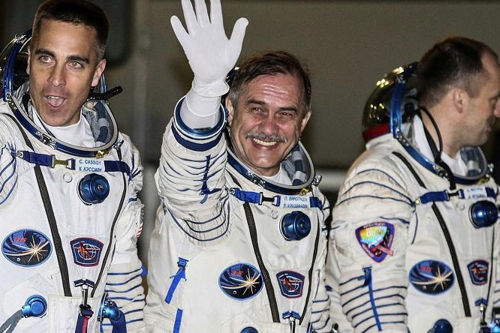
Proficiency
Diversity
Trust & Vulnerability
Mutual accountability
Accepted approach
Equals in value
Colleagues & competitors
Self-managed
Common purpose
Results based
Performance awareness

Slide 34
The Team Benefit Formula
+
+
=
Collaborate
Challenge
Compete
Perform
Leverage diverse skill sets and allow others to be the best at what they do, so you can be the best at what you do.
Push each other beyond your previous limits based on mutual accountability of not letting your fellow teammates down.
Use managed competition to get the best out of each performer through chasing them or being chased.
When the stakes are high and the world is changing, all team members are ready to win and take on greater challenges.

Slide 35
TAKEAWAY #4:
USING CLIENT-CENTRIC TEAMS
CLIENT TEAMS
INDUSTRY TEAMS
ISSUE AND INCIDENT TEAMS

Slide 36
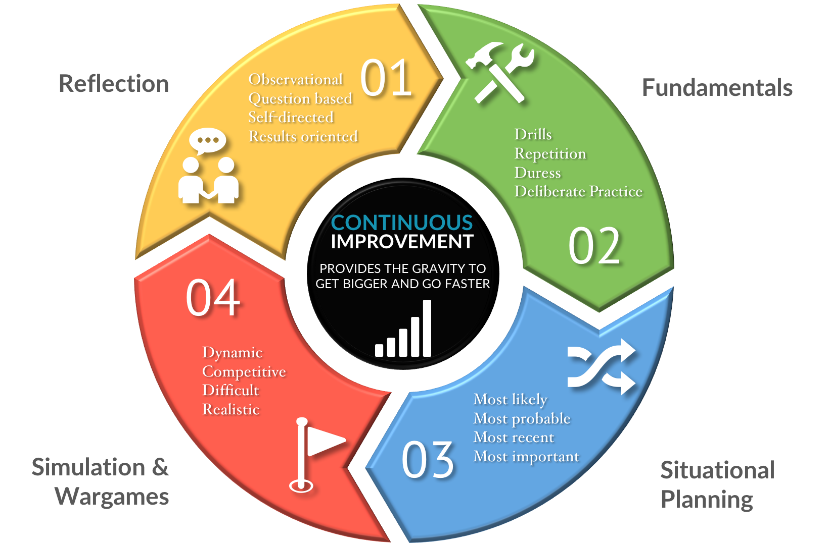
The Octane Coaching Model

Slide 37
HOW DO YOU BUILD A
GREAT TEAM?

Slide 38

Can fly! Strong!
Super Speed!
Laser vision
Makes a mean omelet
(and bulletproof)
Can talk to animals

Slide 39

Identify diverse skills needed
Find specialists, not generalists
Deemphasize titles and status
Require acceptance of the social contract and standards
Have most work completed outside official meetings
Give organizational guidance, but Allow self management
Demand mutual accountability
Use managed competition within team and between other teams
Keep score!

Slide 40
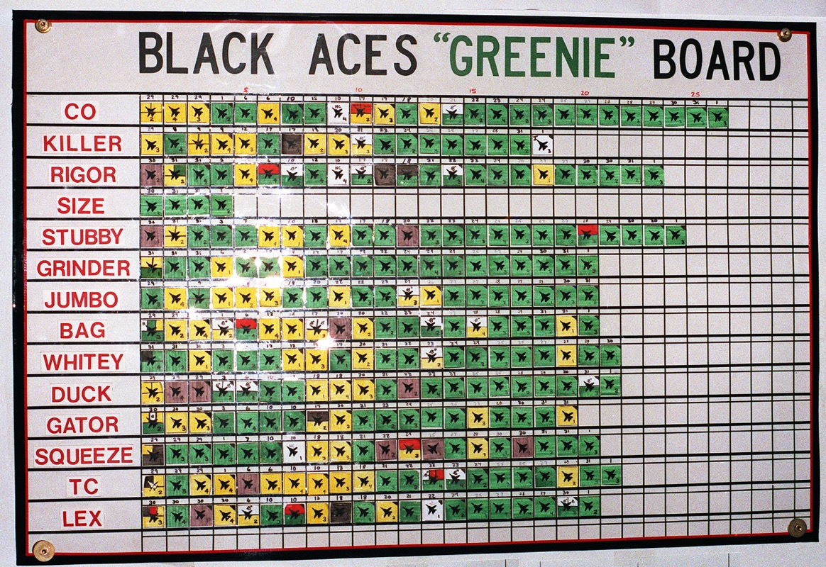
THE “GREENIE BOARD”: EVERYONE GETS A GRADE. EVERYONE!

Slide 41
Three Essential Components to Performance (all levels)
+
+
=
Train
Coach
Lead
Team Success
Skill development and behavior modification conducted and reinforced within teams
One-on-one discipline to make each individual performer better at what they do every day
Vison, perspective and direction from those at the top who then know how to get out of the way
Fulfillment of the team purpose while developing more high performing individuals along the way

Slide 42
TAKEAWAY #5:
USING STRATEGIC TEAMS
CRISIS and response TEAMS
MERGER and expansion TEAMS
GROWTH AND PROSPERITY TEAMS

Slide 43
FINAL TAKEAWAYS
DO NOT CREATE POTENTIAL. BE KINETIC!

Slide 44
Teams develop great performers, not the other way around. You will not find any exceptions.
People leave and can be replaced. Competitors can copy your approach or strategy. However, your teams are unique. That is why they are your most valuable asset.
Team members collaborate, compete and keep each other honest about their performance.
The best approach in improving your organization is to get more out of the assets you already have, and that improvement is exponential when you leverage teams instead of individuals.
You will never have more than a handful of rainmakers until you start building, supporting and rewarding a team-centric training model. You have all the pieces. Start now.
Takeaways

Slide 45
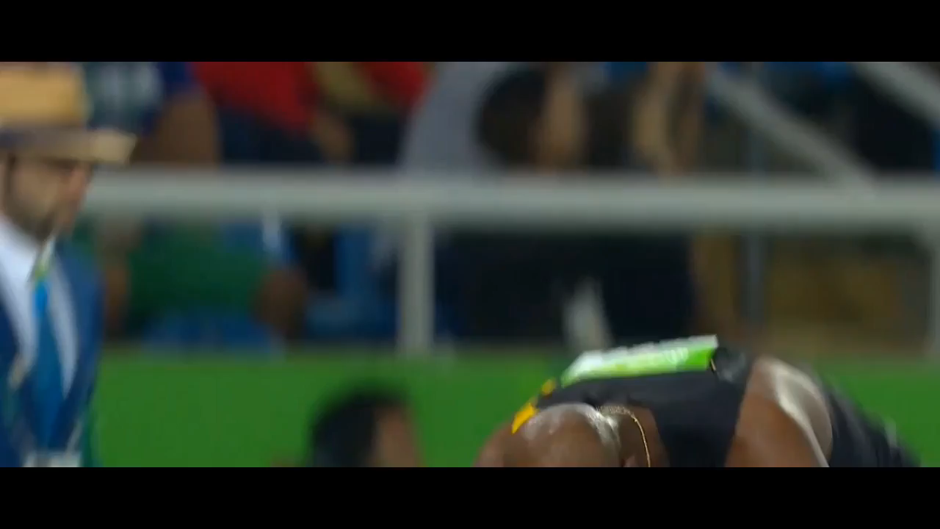

Slide 46
Let’s get to work.
EXCEPTIONAL INDIVIDUALS ON EXCEPTIONAL TEAMS NEED EXCEPTIONAL COACHES.

Slide 47
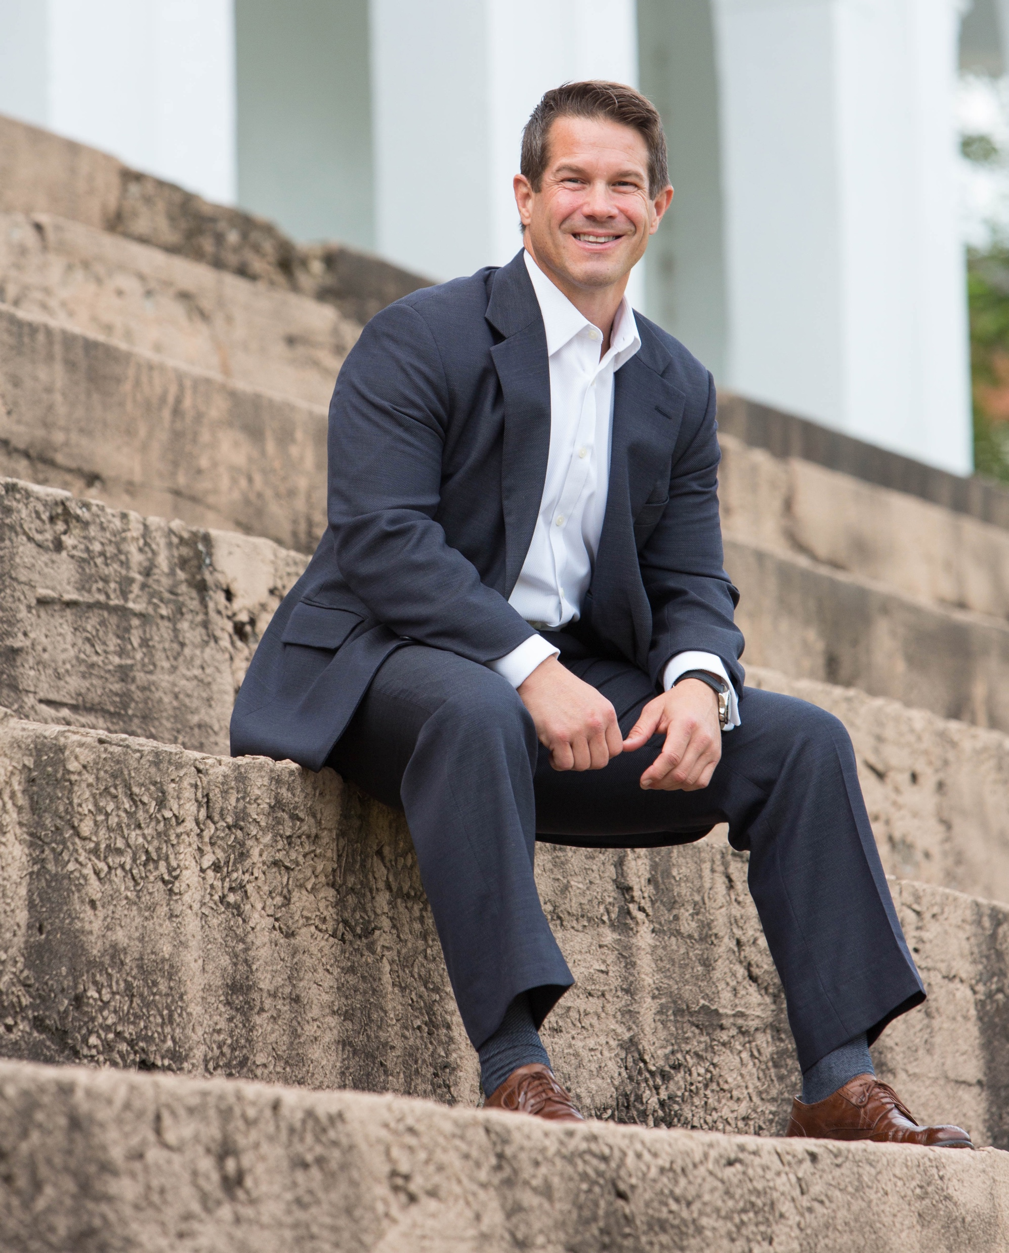

Sign up for podcasts and webcasts at www.highperteams.com
Darryl Cross
Chief Performance Officer
dc@highperteams.com
1.630.945.0752
@darrylcross
Notes:
Delete pictures
Drag and Drop your images

