Slide 1
Nigel Williams
Visualfiles Product Manager
Visualfiles Update
Enterprise Solutions

Slide 2
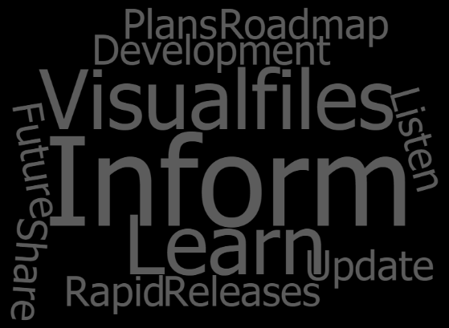
MY TOPICS
What’s new in Visualfiles
Accelerators
Your ideas
Your training & development
Partner Ecosystem
Plans

Slide 3
What I share today reflects our current thinking, but the information may include early ideas and so may be subject to change
It includes information about potential future products and/or product enhancements
Any future products we ultimately deliver may be materially different from what I present today!
Please do not communicate this information outside your organisation without our prior written approval

Slide 4
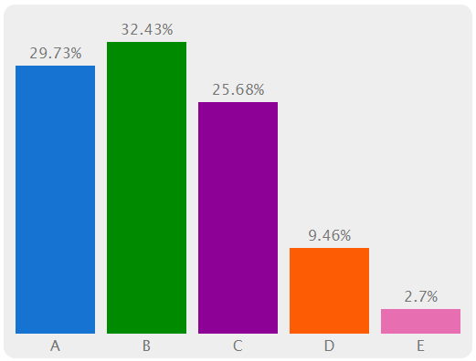
QUESTION TIME – YOUR LIVE VERSION
WHAT VERSION OF VISUALFILES ARE YOU RUNNING IN LIVE?
80 responses
A: Visualfiles v2
B: Visualfiles v3.0 – v3.3
C: Visualfiles v3.4 – v3.5
D: SolCase and proud!
22 24 19 7 2
E: No idea!

Slide 5
Online release timeline
http://cdn.knightlab.com/libs/timeline3/latest/embed/index.html?source=1ryhemM8lYXydy2904_rWXx5_jcBAJqvqbc2or6xPNzQ&font=Default&lang=en&initial_zoom=0&height=700

Slide 6
RECENT RELEASE TIMELINE
Q1 2016 |  |  | Q2 2016
Q4 2016
Q1 2017
Visualfiles v3.3
(Mar 16)
Visualfiles v3.4
(Jun 16)
Visualfiles v3.5
(Oct 16)
Visualfiles v3.7 (anticipated Mar 17)
Data Security Configuration
Secure your data at rest & in transit
Basic Document Preview
View History documents without opening them
SOS Contact Integration
Multiple contact integration for SOS
Real-time SQL Data (Pro2SQL) Beta
Power your BI requirements
Visualfiles Installer Improvements
Windows 10 certification
Minor enhancement requests/bug fixes
Real-time SQL Data Repository (Pro2SQL) Early Adopter
Power your BI requirements
LexisSmart Forms Enhancements
Further improvements to functionality
Outlook Plus Improvements
Office 2016 Certification
iManage 9.3 Certification
SDK Licensing Enhancements
Minor enhancement requests/bug fixes
“Consolidation release”
Minor enhancements including Visualfiles Online
60+ bug fixes
Pro2SQL EA feedback enhancements
History Plus EA feedback enhancements
New API to support future new Word integration for EA
HP RM8 DMS integration
Bug fixes
Visualfiles v3.6
Limited release
(internal only – Dec 16)
SolCase v7.8
Office 2016 certification
(Nov 2016)

Slide 7
RELEASE HIGHLIGHTS
PRO2SQL : Real-time SQL data warehouse, automatically extracted from Visualfiles – “ETL”
History Plus: feedback from the early adoption programme in Australia has influenced enhancements
Visualfiles Online: enhancements to support greater functionality and the new Online accelerator
Lexis SmartForms: integration with LN PDF forms
Data Security: GDPR is just around the corner!

Slide 8
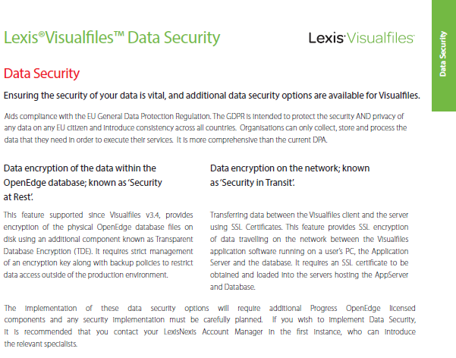
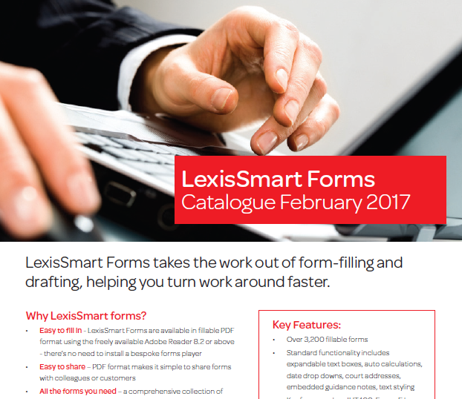
RELEASE HIGHLIGHTS

Slide 9
VISUALFILES V3.7
ETA 30th March
History Plus & Pro2SQL
New API for Word
HP RM8 Integration

Slide 10
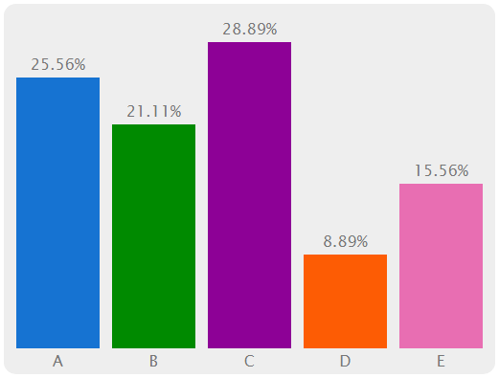
QUESTION TIME – UPGRADING VISUALFILES
WHAT IS THE MAIN BARRIER TO YOU UPGRADING REGULARLY?
99 responses
A: FINANCIAL COST
B: COMPLEXITY OF INSTALLATION
C: COMPLEXITY OF TESTING
D: NO BUSINESS DEMAND
23 19 26 8 14
E: THERE IS NO BARRIER

Slide 11
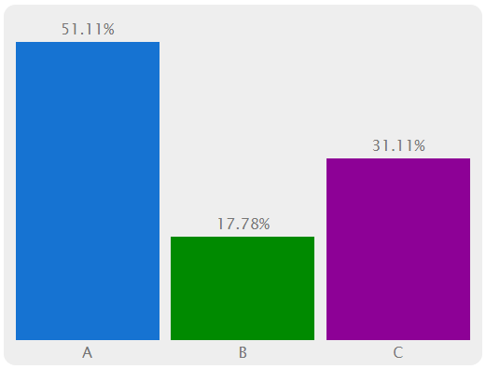
QUESTION TIME – UPGRADING VISUALFILES
IF WE OFFERED FREE UPGRADES TO YOUR TEST SYSTEM
WOULD IT MAKE A DIFFERENCE?
101 responses
A: DEFINITELY YES!
B: NO
46 16 28
C: POSSIBLY

Slide 12
VISUALFILES ACCELERATORS
What?
Rapid development solution
New Application, Add-in & Entity package
Rich out-of-the box functionality
Risk & Compliance
Matter Estimation
Conveyancing
Probate
File Management
Debt Recovery
Client App 1
Client App 2
Client App 3
ACCELERATOR FRAMEWORK
Standard Entities
Client Specific Entities
Visualfiles Toolkit

Slide 13
VISUALFILES ACCELERATORS
What?
Rapid development solution
New Application, Add-in & Entity package
Rich out-of-the box functionality
Risk & Compliance
Matter Estimation
Conveyancing
Probate
File Management
Application Entity
Debt Recovery
Client App 1
Client App 2
Client App 3
Framework Application
ACCELERATOR FRAMEWORK
Standard Entities
Client Specific Entities
Parties Addin
Visualfiles Toolkit

Slide 14
VISUALFILES ACCELERATORS
Why?
Common look & feel for solutions
Minimise the development effort
Simplify the need for advanced scripting skills
Quicker delivery & RoI
Risk & Compliance
Matter Estimation
Conveyancing
Probate
File Management
YOUR AccelApp 1
YOUR AccelApp 2
Debt Recovery
Client App 1
Client App 2
Client App 3
ACCELERATOR FRAMEWORK
Standard Entities
Client Specific Entities
Visualfiles Toolkit

Slide 15
VISUALFILES ACCELERATORS
How?
This afternoon’s “Building with Accelerator Framework”
Package available
Services to install, configure and train
Interested?...
Risk & Compliance
Matter Estimation
Conveyancing
Probate
File Management
YOUR AccelApp 1
YOUR AccelApp 2
Debt Recovery
Client App 1
Client App 2
Client App 3
ACCELERATOR FRAMEWORK
Standard Entities
Client Specific Entities
Visualfiles Toolkit

Slide 17
https://visualfiles.ideas.aha.io/ VISUALFILES IDEAS PORTAL

Slide 18
https://visualfiles.ideas.aha.io/ VISUALFILES IDEAS PORTAL
Ideas portal live in July 2016
202 transferred, 282 new!
All triaged, 30% taken further, 50+ ideas ‘available or in development’

Slide 19
YOUR FUTURE – TRAINING & CERTIFICATION
Visualfiles Developer Expert
Visualfiles Admin Expert
Visualfiles Business Support Expert
Validation & Certification (Theory & Practical)
specialist
Visualfiles Developer Modules
Visualfiles Admin Modules
Visualfiles Business Support Modules
A
B
C
D
E
A
B
C
D
E
A
B
C
D
E
Validation & Certification (Theory)
core
Visualfiles Foundation
Visualfiles Admin
Visualfiles End User Prep

Slide 20
PARTNER ECOSYSTEM
Extending our relationships – new partners…
Extending our relationships – new partners…
Maluma
Data manipulation & reporting specialists with technical Progress skills

Slide 21
PARTNER ECOSYSTEM
Extending our relationships – new partners…
Maluma
Rubix
Visualfiles experts with PI & insurance experience: varied apps & add-on solutions

Slide 22
PARTNER ECOSYSTEM
Extending our relationships – new partners…
Maluma
Rubix
Software Cloud
Experts in cloud and Microsoft technologies

Slide 23
PARTNER ECOSYSTEM
Extending our relationships – new partners…
Maluma
Rubix
Software Cloud
Squared Bracket
Scottish partner with extensive Visualfiles development & admin experience

Slide 24
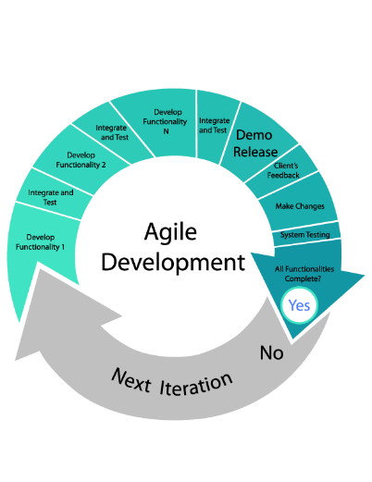
WHAT BEGAN IN 2016 CONTINUES IN 2017
The following areas are the focus for ongoing roadmap activity
Note: This represents LexisNexis’s current view of its product direction and should not be interpreted as a commitment on the part of LexisNexis.
Until LexisNexis releases any version of this software in a particular country, product availability, features and dates are subject to change without notice.
DOCUMENT PRODUCTION & MANAGEMENT
INTEGRATIONS & CERTIFICATIONS
DELIVERY OF SIMPLIFIED WORKFLOW FRAMEWORK & ACCELERATORS
“OPENING UP VISUALFILES” CONTINUES
SDK & MICROSOFT DEVELOPMENT
OFFICE TOOLS FOR VISUALFILES
DIGITAL TRANSFORMATION TECHNOLOGIES
MOBILE/ONLINE
ANALYTICS
CLOUD
SOCIAL BUSINESS (COLLABORATION)

Slide 25
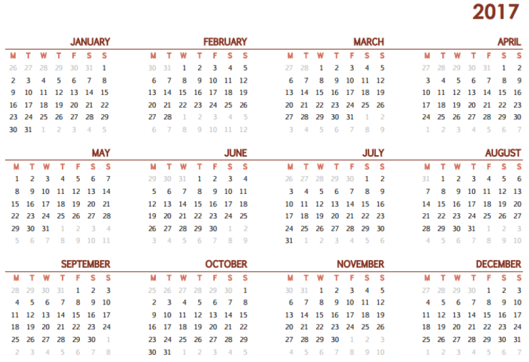
WITH NEAR TERM FOCUS ON…
MICROSOFT OFFICE INTEGRATION
FRAMEWORK & ACCELERATORS
IDEA PORTAL FAVOURITES
DEVELOPER TOOLS
CERTIFICATIONS
ONGOING SUPPORT
Note: This represents LexisNexis’s current view of its product direction and should not be interpreted as a commitment on the part of LexisNexis.
Until LexisNexis releases any version of this software in a particular country, product availability, features and dates are subject to change without notice.
V3.7
V3.8

Slide 26
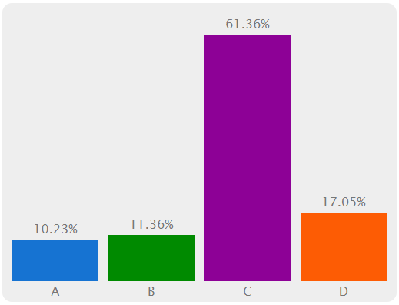
QUESTION TIME – RELEASE FREQUENCY
HOW FREQUENTLY WOULD YOU LIKE US TO RELEASE NEW VERSIONS OF VISUALFILES? – CURRENTLY 2 PER YEAR
102 responses
A: MORE FREQUENTLY
B: LESS FREQUENTLY
C: IT’S ABOUT RIGHT
D: IT MAKES NO DIFFERENCE
9 10 54 15

